Slide 1

Sustainability at IITH
Sustainability Committee
IIT Hyderabad

Slide 2
What is Sustainability?
Sustainability refers to meeting the needs of the present without compromising the ability of future generations to meet their own needs. It balances environmental protection, economic development, and social well-being.
Why Sustainability Matters for Growth of Humanity
Preserves Natural Resources: Ensures long-term availability of water, food, energy, and raw materials.
Supports Economic Stability: Promotes efficient resource use, innovation, and resilient economies.
Enhances Quality of Life: Improves health, equity, and living standards across societies.
Protects the Planet: Reduces environmental degradation, climate risks, and biodiversity loss.
Key Message Sustainability is not a limitation on growth—it is the foundation for long-term human progress and survival.

Slide 3
Why we need sustainability education in any university?
Making a sustainable world would require all of us to work together.
Everyone has a role to play irrespective of who you are or what you do.
🔬 Science (Natural & Applied Sciences)
Provides data-driven understanding of climate and ecosystems
Drives innovation through research and discovery
Informs evidence-based solutions and sustainable practices
⚙️ Engineering
Develops energy-efficient systems and infrastructure
Enables renewable energy, green manufacturing, and smart technologies
Ensures safety, durability, and responsible resource use
📚 Liberal Arts (Humanities, Social Sciences, Policy, . . .)
Guides ethical decision-making and social responsibility
Shapes public awareness, culture, and sustainable policies
Ensures equity, justice, and human-centered development
🎨 Design (Product, UX, Architecture, Media)
Shapes sustainable user behavior and consumption patterns
Promotes circular design, minimal waste, and inclusive solutions
Influences long-term environmental and social impact through sustainable choices

Slide 4


Slide 5


Slide 6
The United Nations Sustainable Development Goals
A shared global framework for understanding what being “sustainable” actually means.
The UN Sustainable Development Goals (SDGs) were officially adopted by world leaders at the UN General Assembly in September 2015, as part of the 2030 Agenda for Sustainable Development, coming into force on January 1, 2016, to guide global efforts against poverty, inequality, and climate change.
While the concept of sustainable development began much earlier (e.g., Brundtland Report in 1987), the specific 17 SDGs emerged from a long consultation process following the 2012 UN Conference on Sustainable Development in Rio de Janeiro.

Slide 7
The world does not suffer from a lack of good intentions. It suffers from fragmented priorities.
One country focuses on growth. Another on poverty. Another on climate. Another on education.
The 17 Sustainable Development Goals, developed by the United Nations Sustainable Development Goals, exist to solve this fragmentation.
They are not 17 separate problems. They are 17 lenses through which the same system is viewed.
Together, they ask a single question:
Can human progress continue without breaking the systems that support it?

Slide 8
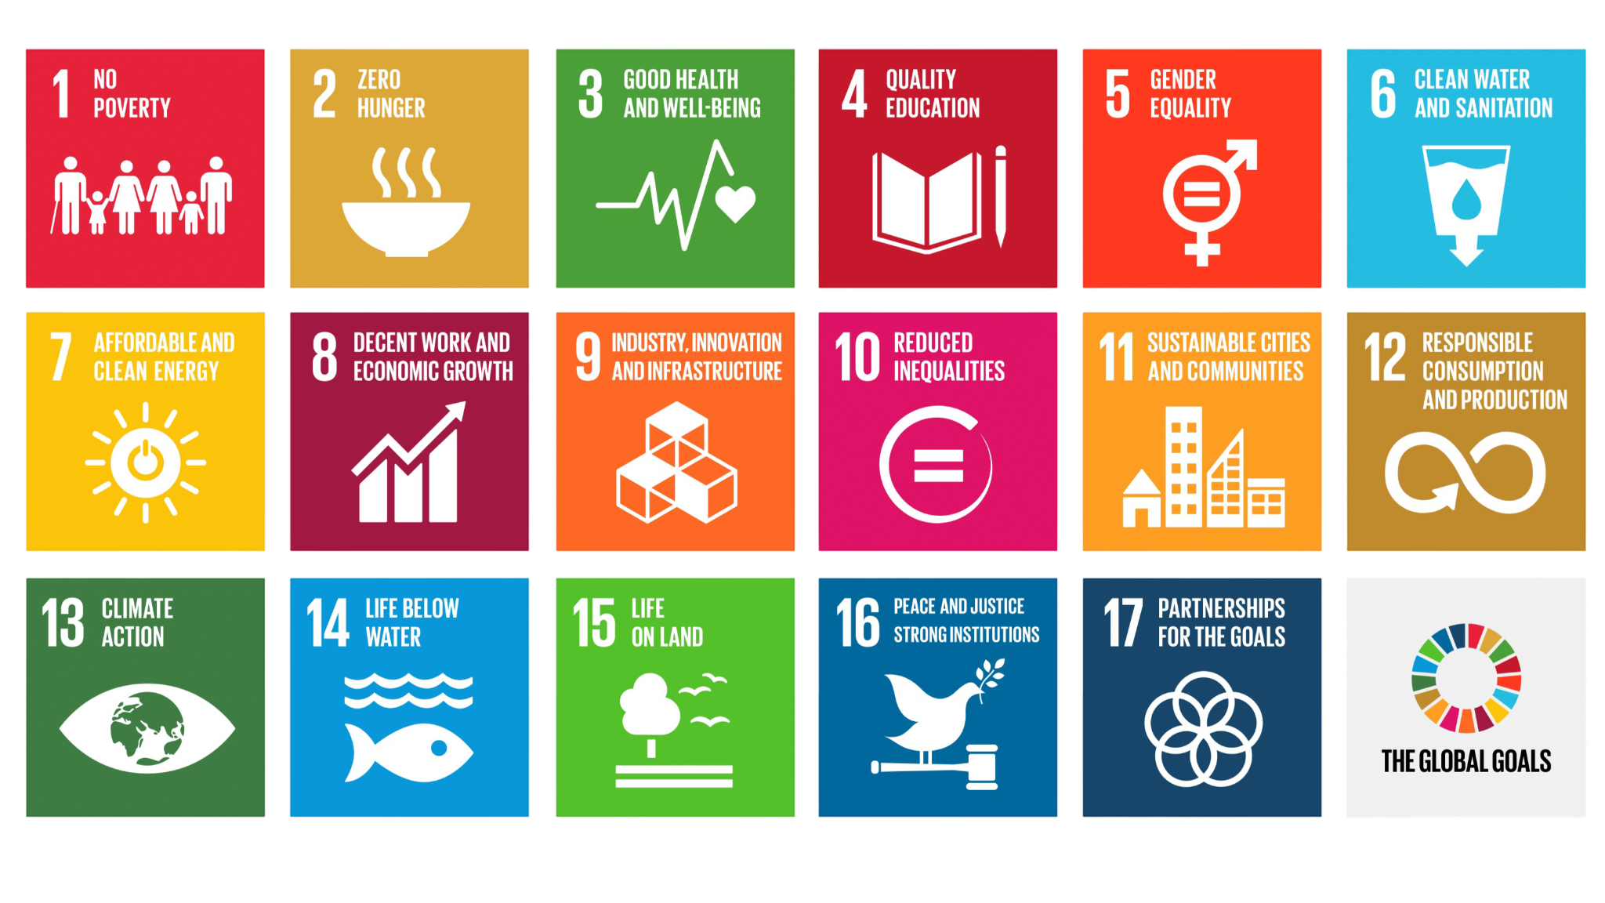

Slide 9
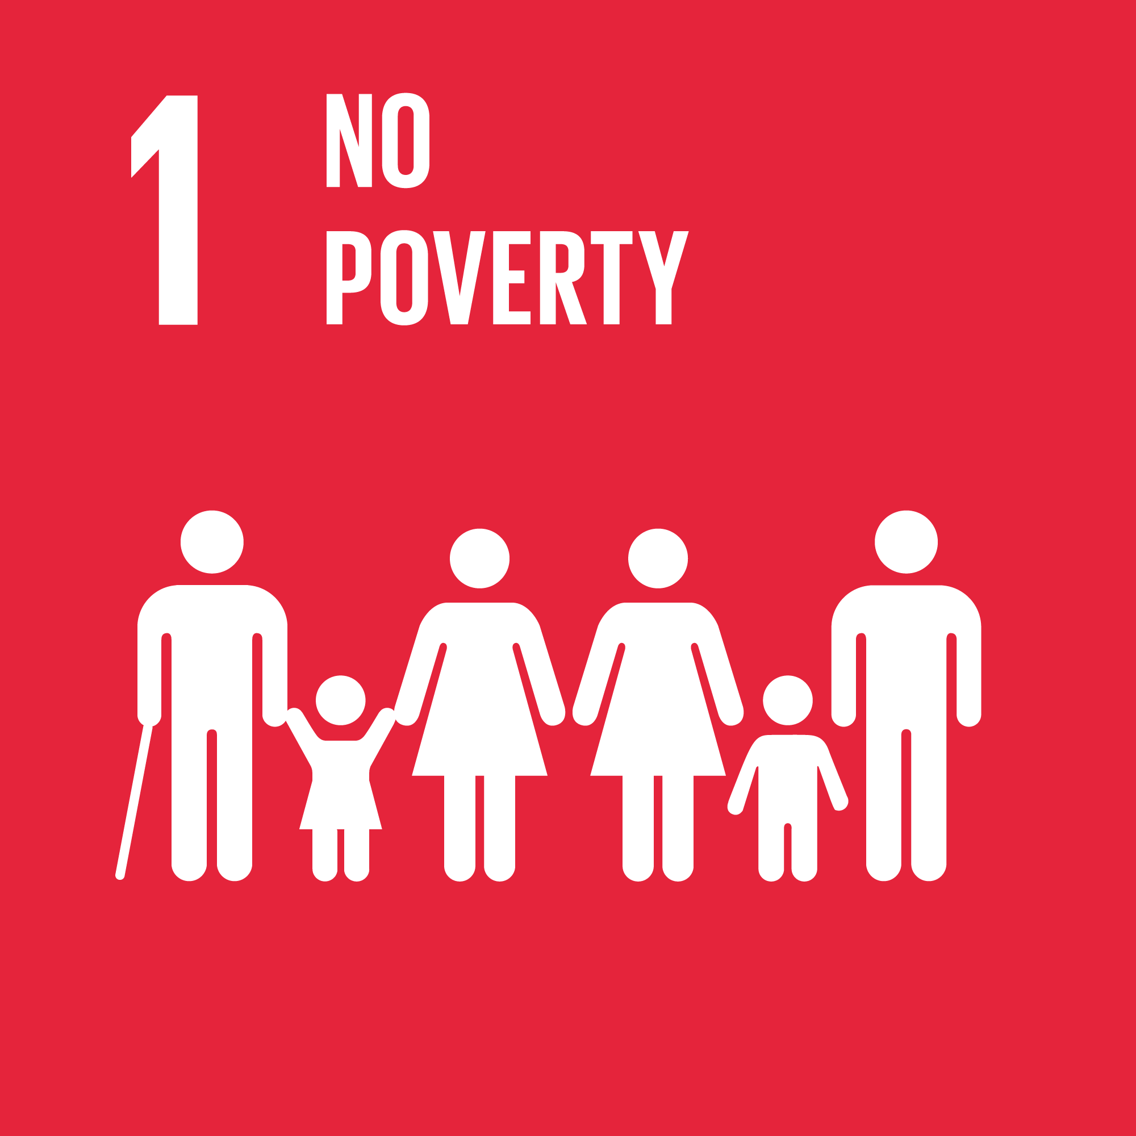
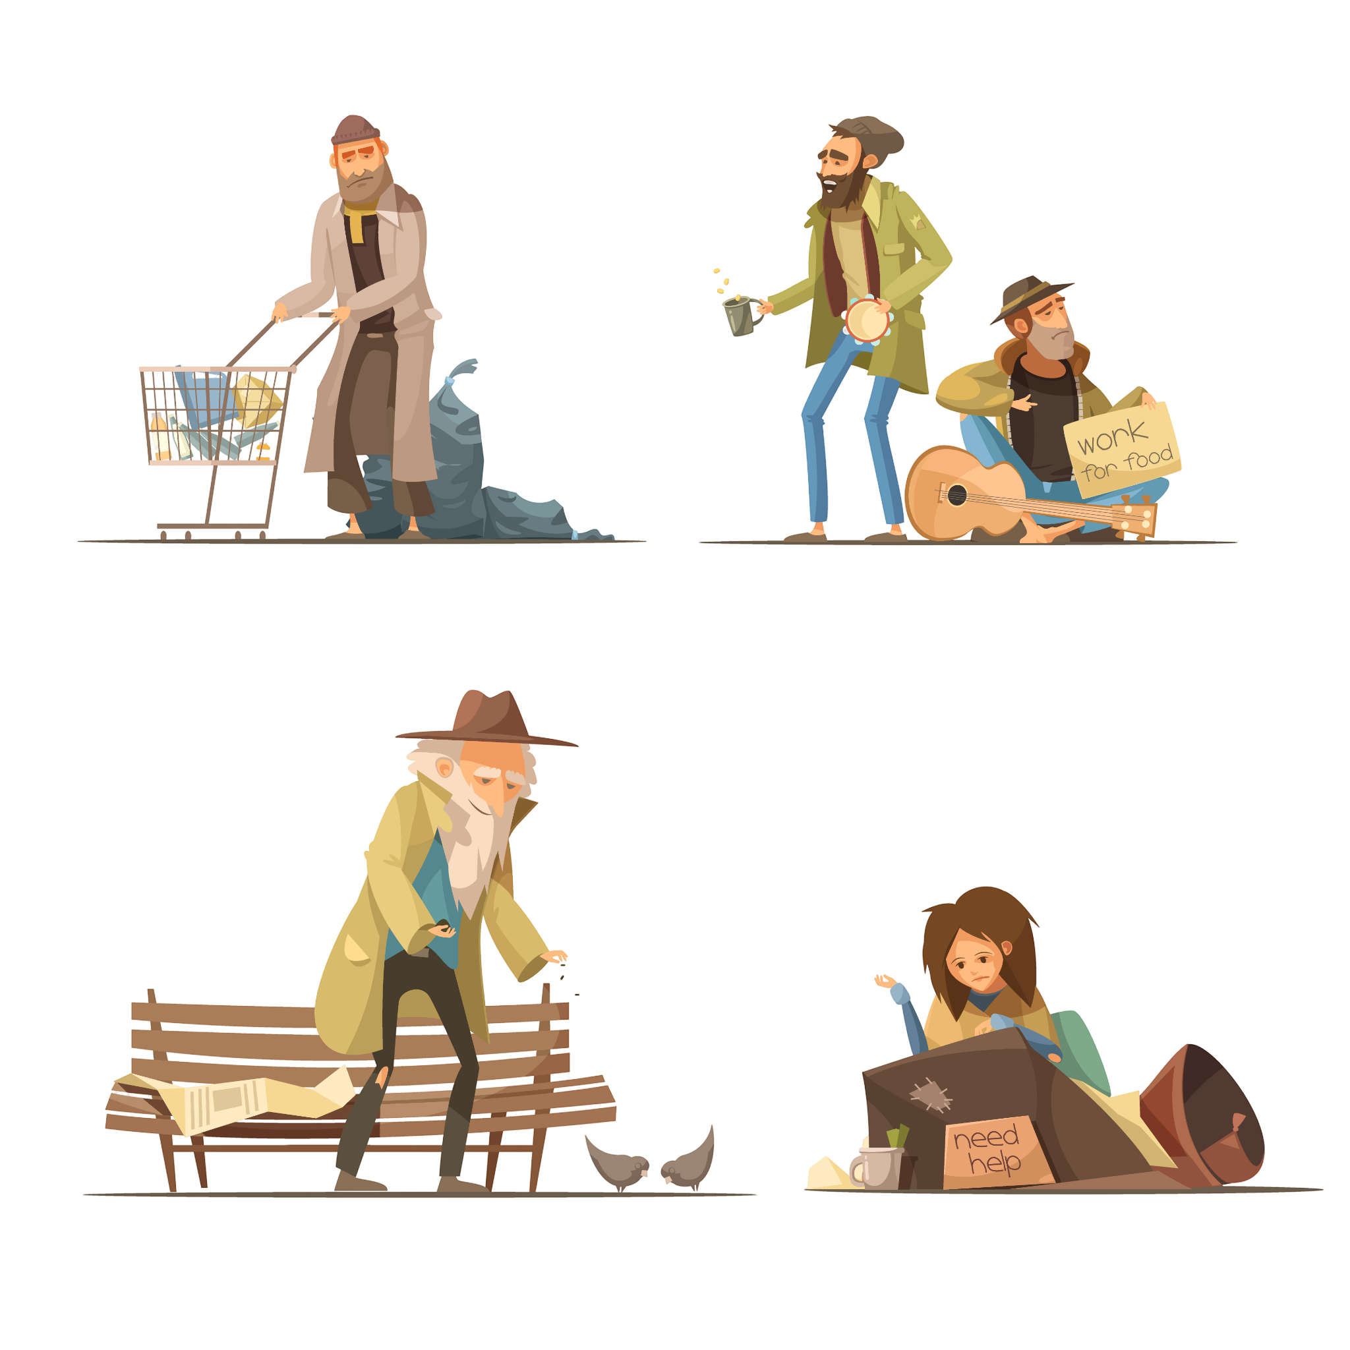
Poverty is more than lack of income
Poverty is not a statistic.
WHAT POVERTY ACTUALLY LIMITS?
Poverty is often represented as a percentage or a target to be met.
But for those living in it, poverty is experienced daily, not statistically.
It is the constant need to choose between essentials, the absence of buffers against shock, and the inability to plan beyond the immediate future.
Poverty limits access to:
Stability and safety
Education and healthcare
Secure work and mobility
Voice in decisions that affect life outcomes
Over time, these limitations reinforce one another.
Ending poverty begins with understanding it clearly.
WHY THIS GOAL MATTERS TO EVERYONE?
Did you know?
Impact of Climate Change on Rural Poverty Vulnerability from an Income Source Perspective
Effect on children growing up in poverty by The Children's Society
Poverty does not remain isolated.
It affects public health, social cohesion, economic resilience, and trust in institutions.
Reducing poverty is not charity. It is foundational to stable and functioning societies.

Slide 10


Slide 11
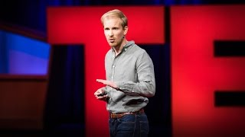

Slide 12
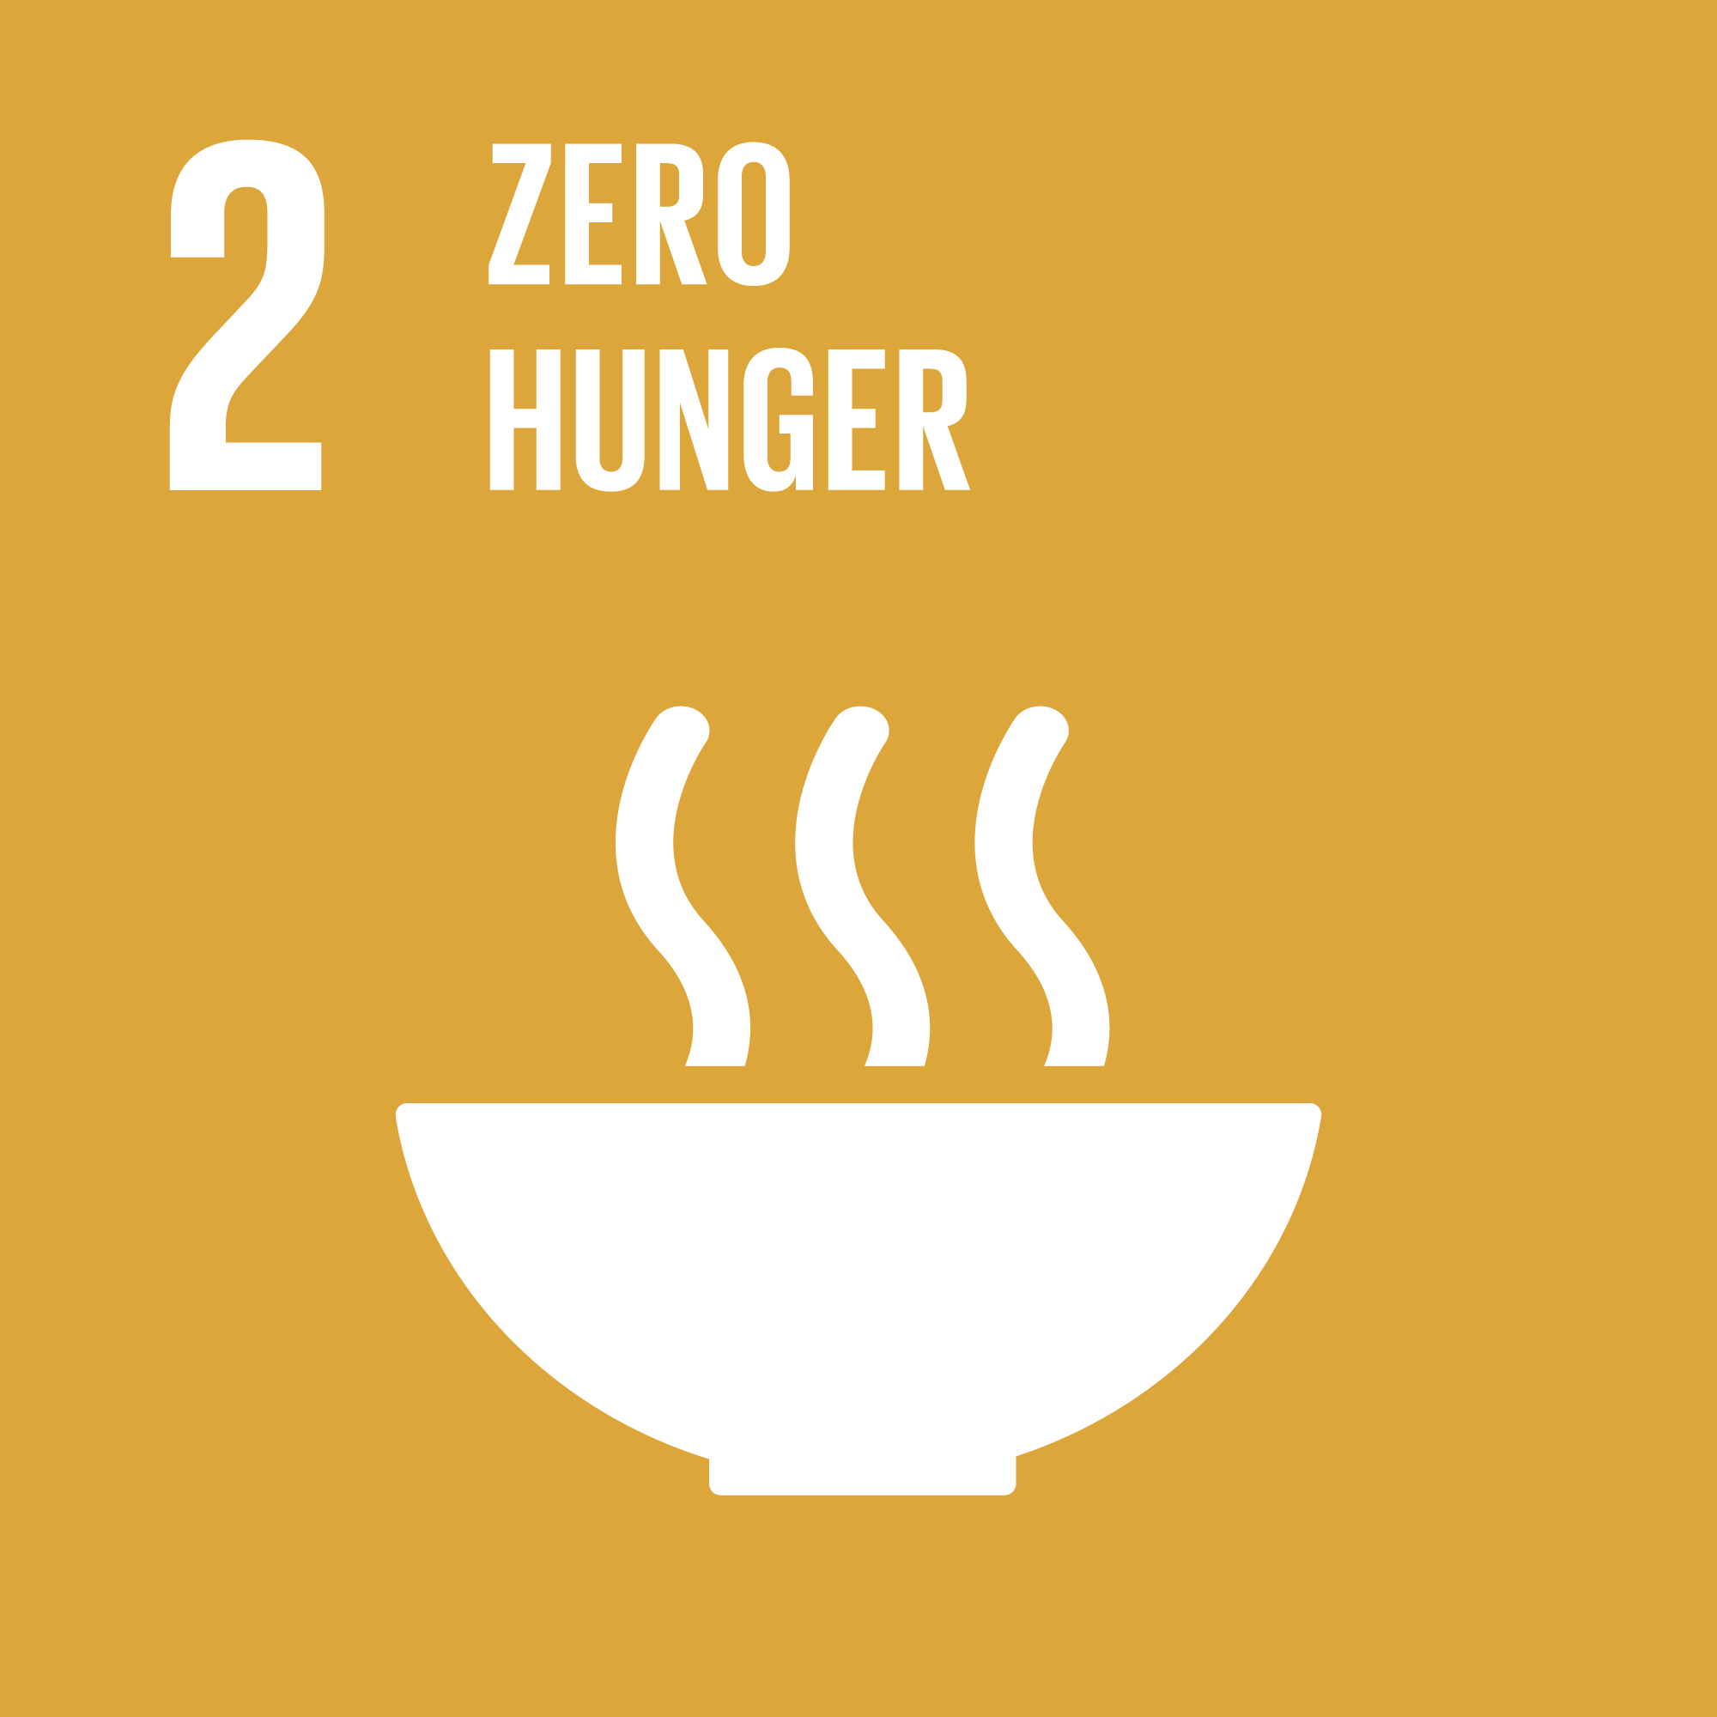

How hunger survives in a world that produces enough food!
THE PARADOX
WHAT HUNGER LOOKS LIKE TODAY
The world produces more than enough food to feed everyone.
Yet hunger persists.
This is not a failure of production. It is a failure of systems.
Hunger is often treated as a humanitarian emergency. But most hunger today is chronic, not dramatic.
It is shaped by:
income instability
rising food prices
fragile supply chains
climate stress on agriculture
food systems optimized for profit, not nourishment
This is why food waste and hunger can exist side by side.
WHY THIS MATTERS EVEN IF YOU ARE NOT HUNGRY
Hunger does not stay contained.
It weakens learning outcomes. It reduces productivity. It strains healthcare systems. It increases vulnerability to shocks.
A society that tolerates widespread undernourishment pays the cost later in invisible ways.
Why does hunger exist in a world of plenty?
World Hunger: Causes, Effects, and Solutions
A global hunger crisis: how did we get here? by Care
How Does Hunger Affect People Throughout Their Life?

Slide 13


What do we mean when we say “I’m fine”?
THE MIRROR
Mental health is not optional!
Most people say they are fine.
But “fine” can mean many things.
Does it mean:
rarely getting sick?
managing stress well?
having energy throughout the day?
sleeping without exhaustion?
feeling mentally steady over time?
Let’s begin by questioning what we accept as normal.
Mental health shapes how people think, decide, relate, and cope.
Stress, anxiety, burnout, and emotional fatigue are increasingly treated as normal, even when they quietly reduce clarity, resilience, and well-being.
Health is shaped before personal choice begins
Well-being is influenced by more than habits.
Work expectations. Access to care. Urban design. Food availability. Social pressure around productivity.
These factors decide how easy or difficult it is to stay healthy long before individual responsibility enters the picture.
Many health problems grow slowly
Poor eating habits and low physical activity
drive many modern health problems.
They develop slowly and are noticed late.
See how impactful they are!
India’s Health Crisis: A Ticking Time Bomb? | Quick Take with Smita Prakash by ANI News
The relationship between unhealthy lifestyle behaviors and depression: Evidence from NHANES

Slide 14


Slide 15
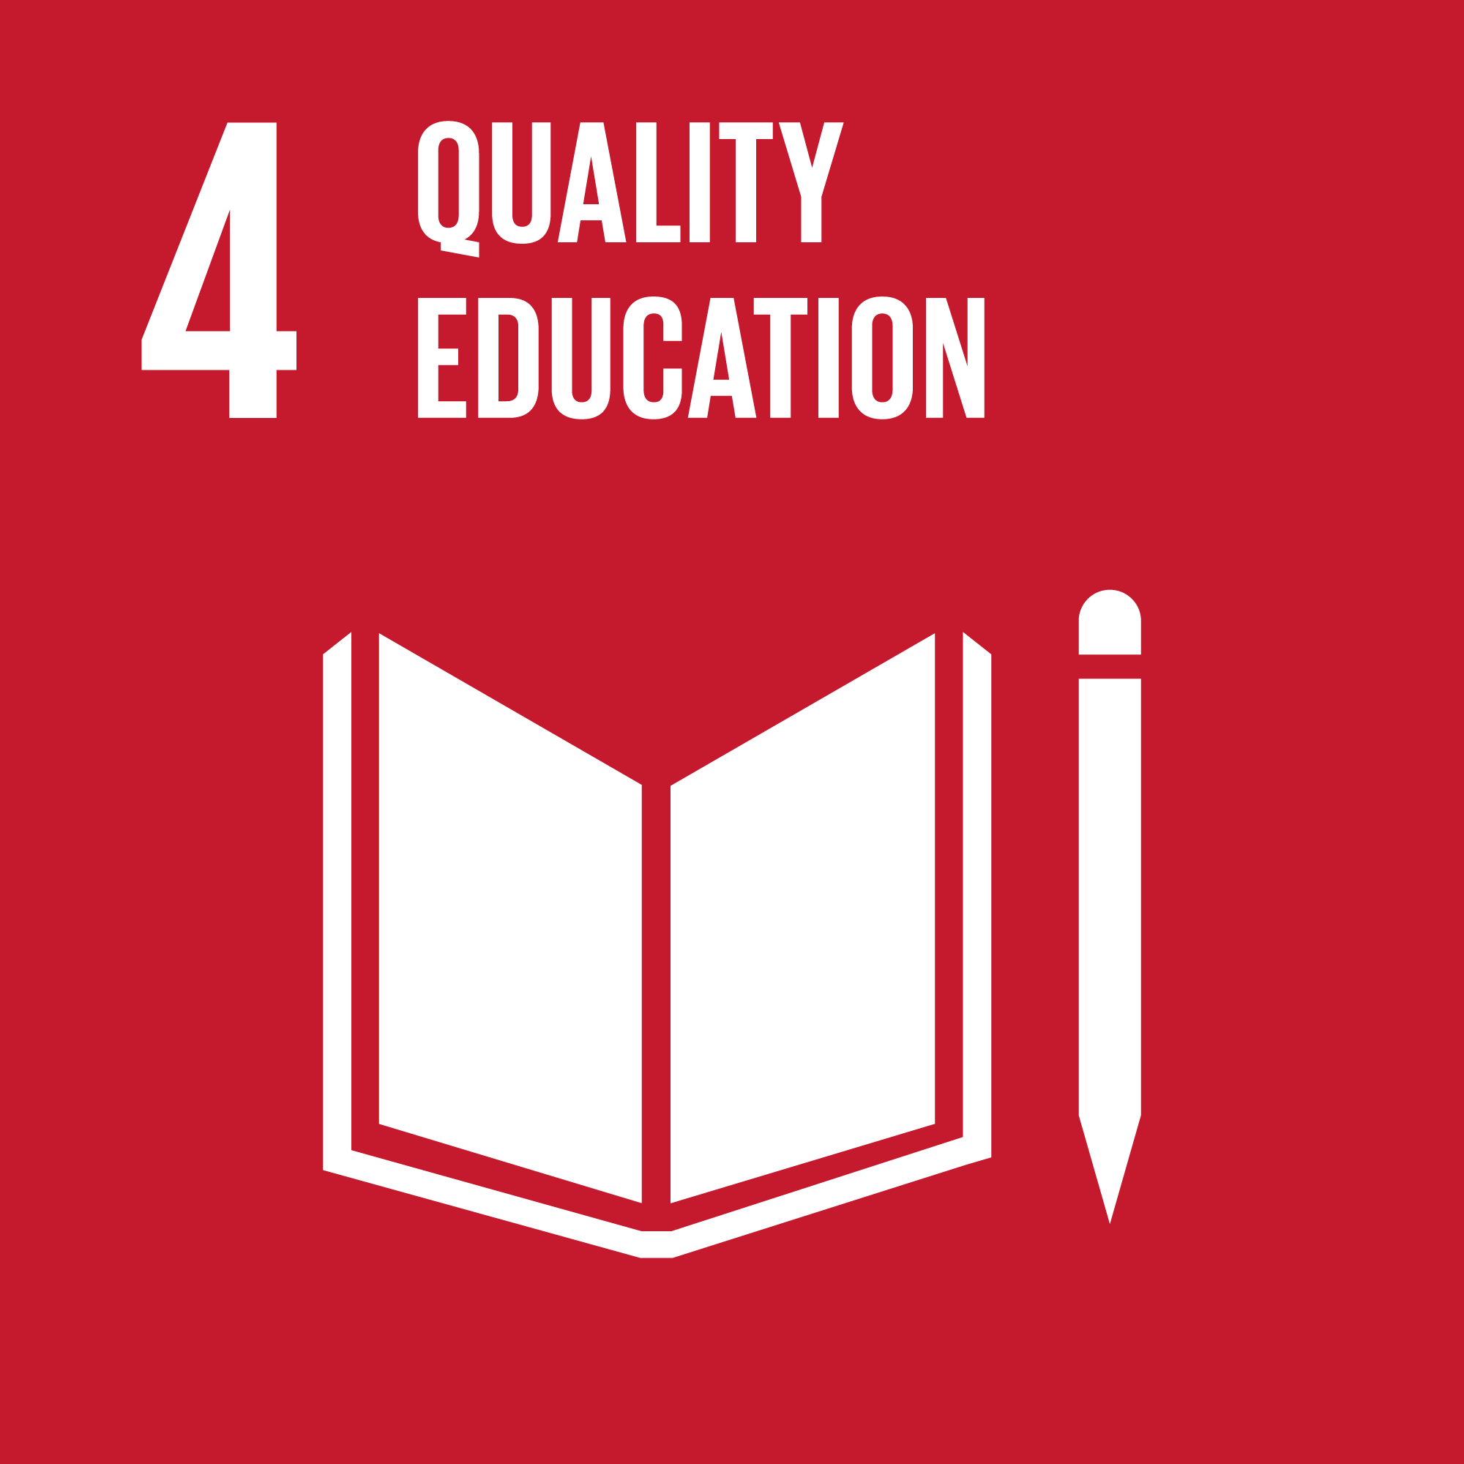

What quality education is meant to enable!
Quality education is about more than access
What quality education is meant to deliver
For many people, access to quality education is shaped by circumstance rather than choice.
Limited schools. Insufficient teachers. Outdated material. Unreliable infrastructure.
Quality education focuses on outcomes.
Literacy and numeracy
Access to vocational and higher education
Skills that support work, entrepreneurship, and participation in society
It also prepares learners to adapt as knowledge, technology, and work evolve.
Education matters when learning leads to real capability, not just progression through a system.
What keeps education effective
Quality learning depends on: trained teachers, inclusive environments, and removing barriers to participation.
Strong education systems increase the value of knowledge everywhere.
Understand its Impact!
Rethinking Quality Education: Perspectives from the Capability Approach
Components of a Quality Education: A literature review
Why Quality Education is important for Modern World? | Mr. Chetan Kapoor | TEDxAIT

Slide 16


Equal opportunity, equal safety, equal voice
Rights, safety, and agency
Why “equal access” does not guarantee equal outcomes
Gender equality focuses on ensuring that everyone can access education, healthcare, work, and public life without barriers.
It also includes safety and dignity, including freedom from violence, harmful practices, and discrimination.
This goal is about real conditions that shape participation, not symbolic statements.
Even in high-performing environments, gaps can persist in outcomes.
Who feels comfortable speaking up. Who gets mentorship and networks. Who is trusted with responsibility. Who faces bias, harassment, or mobility constraints. Who carries disproportionate unpaid care expectations at home.
These patterns are rarely about capability. They are shaped by norms and structures that accumulate over time.
Better participation improves decision quality
When participation is unequal, systems lose insight and potential.
Gender equality improves:
leadership pipelines
research and innovation quality
team performance and culture
Understanding the real gaps:
Gender Equality and Rights: An Analysis of Progress and Challenges
Equality in Decision-Making Positions: The Efficiency Gain

Slide 17


Slide 18
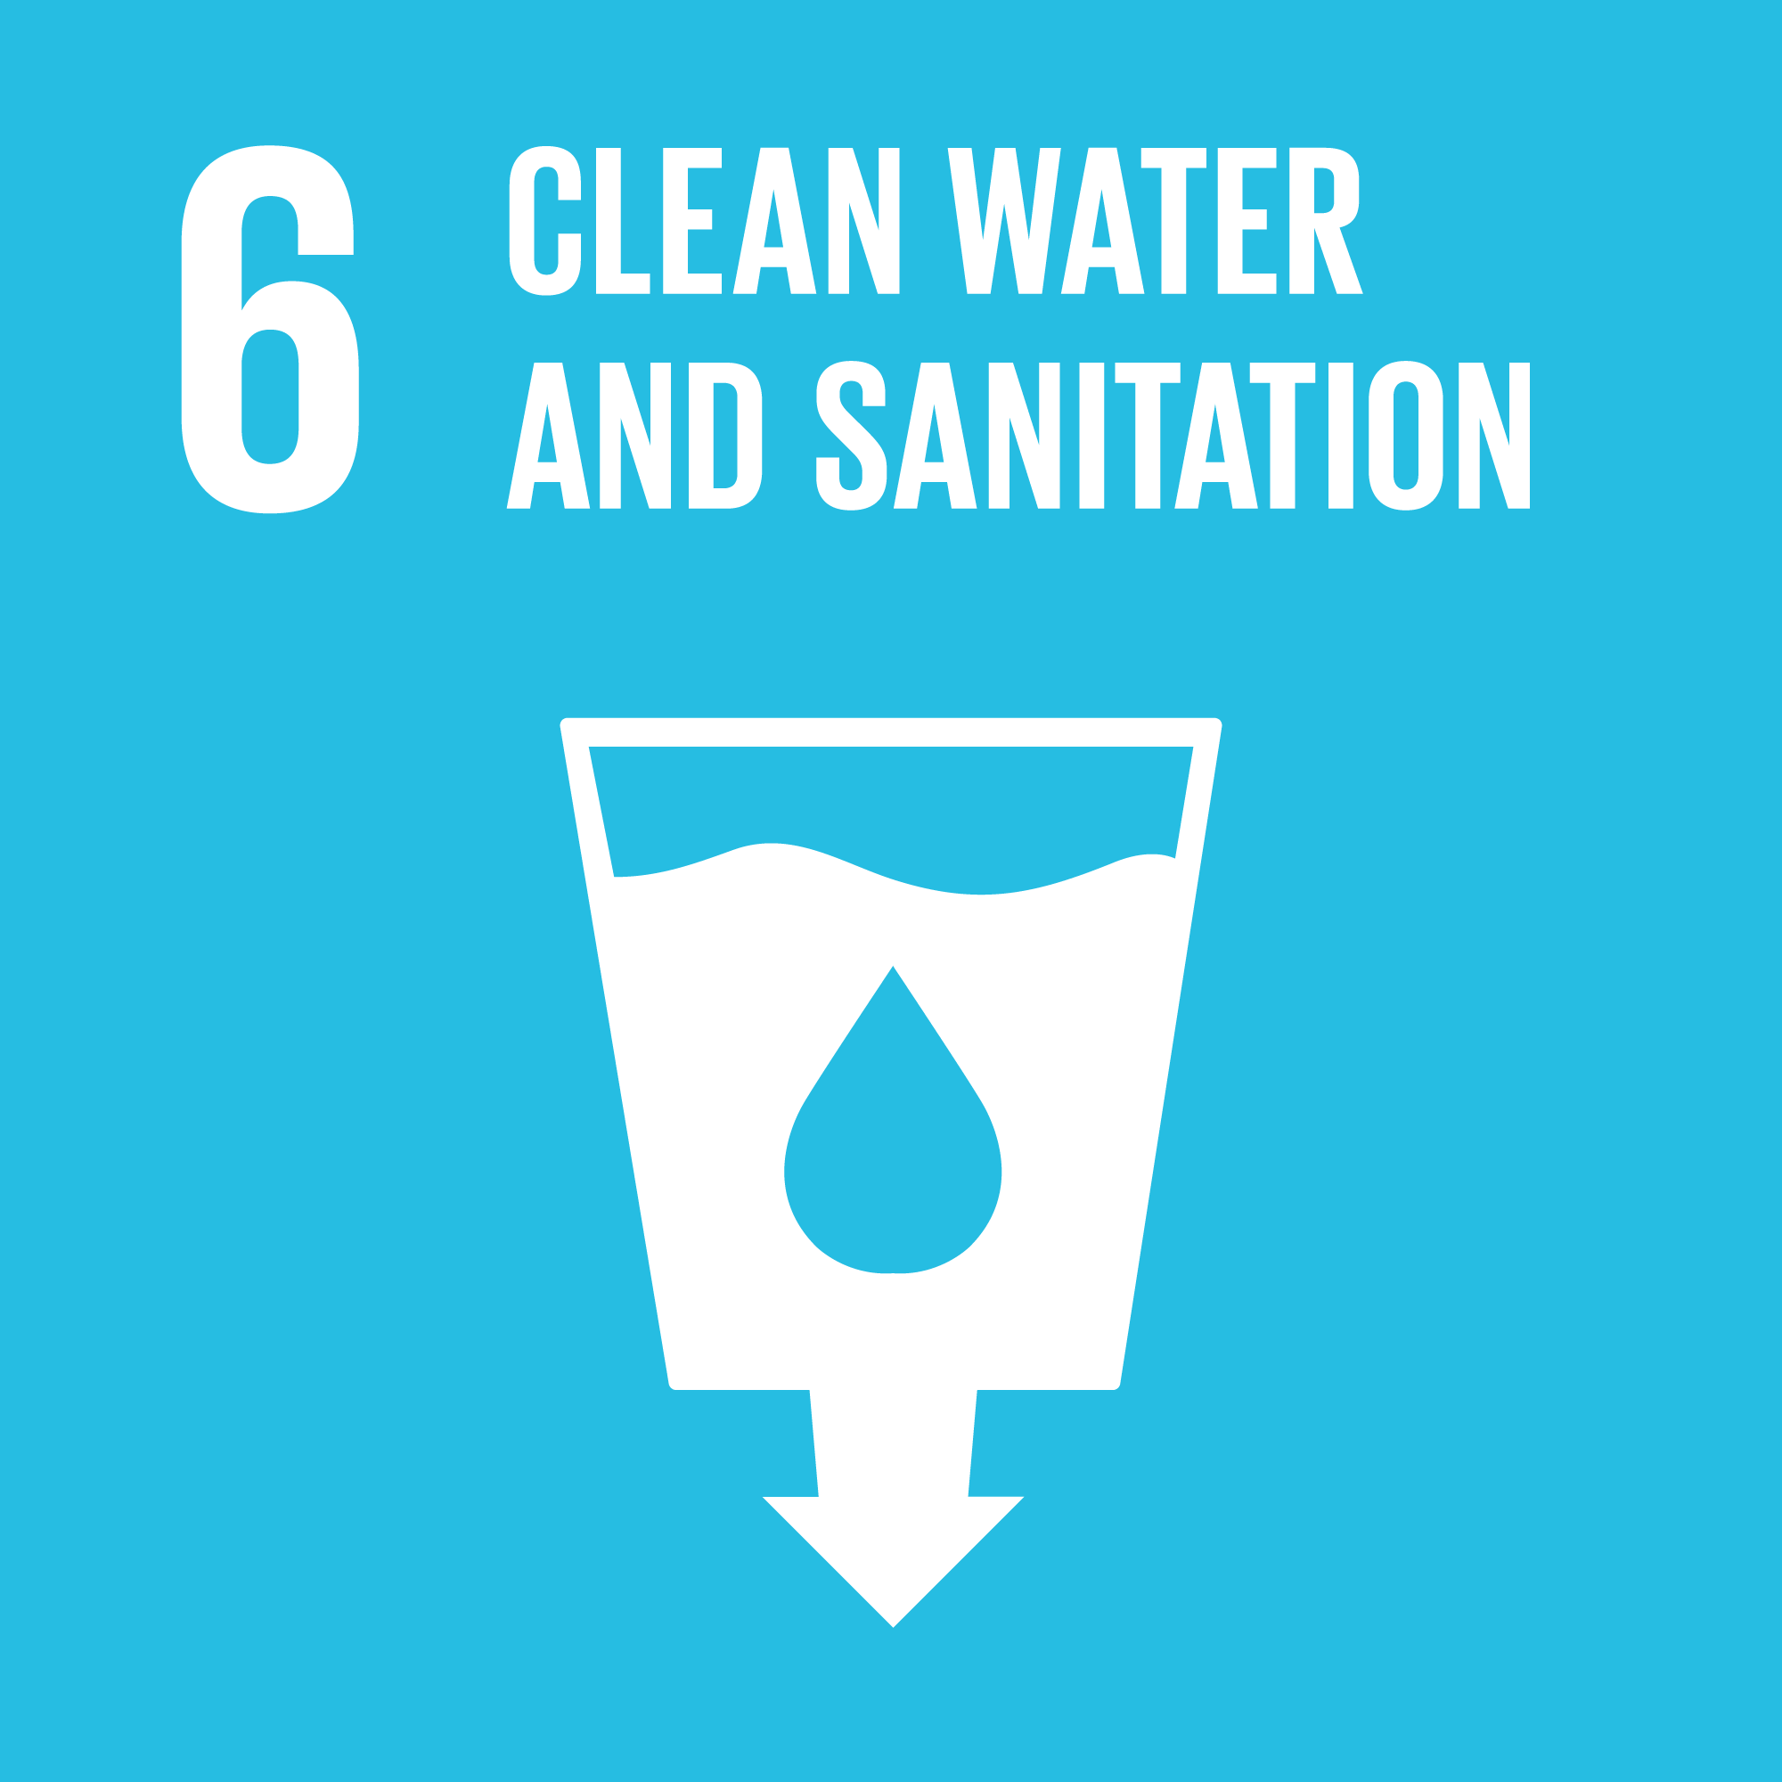
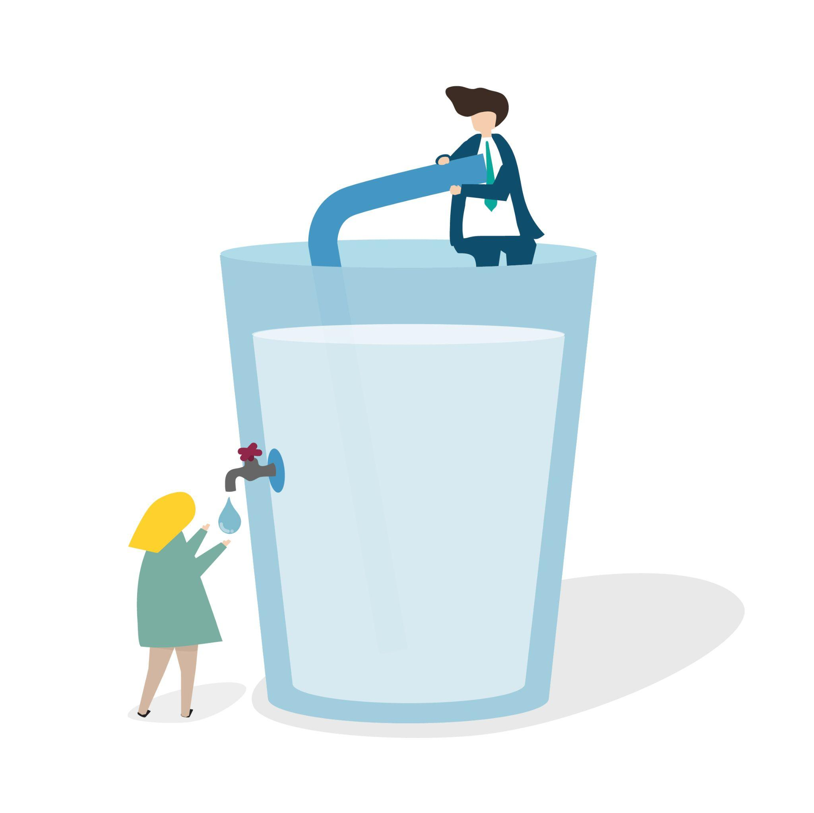
When systems work, water disappears from attention!
Water access is a systems problem
Water security depends on how water moves through systems:
Clean water and sanitation are not defined only by availability.
They depend on infrastructure, management, and reliability.
Safe drinking water. Functional sanitation. Wastewater treatment.
Hygiene facilities in homes, schools, and public spaces.
Ensure, wastewater is treated, not released untreated
Pollution and hazardous dumping are controlled
Water is reused safely where possible
Freshwater withdrawals stay within sustainable limits
Efficiency improves across agriculture, industry, and cities
Water is managed across regions, not in isolation
Scarcity is rarely caused by absence of water alone. It is caused by weak management across the chain.
Where does water security actually begin?
Water security begins upstream.
Natural ecosystems are not separate from infrastructure.
Ecosystem protection and local capacity keep systems running.
What keeps water systems working!
WHO global water, sanitation and hygiene: annual report 2024
The role of water, sanitation and hygiene in safeguarding global health

Slide 19
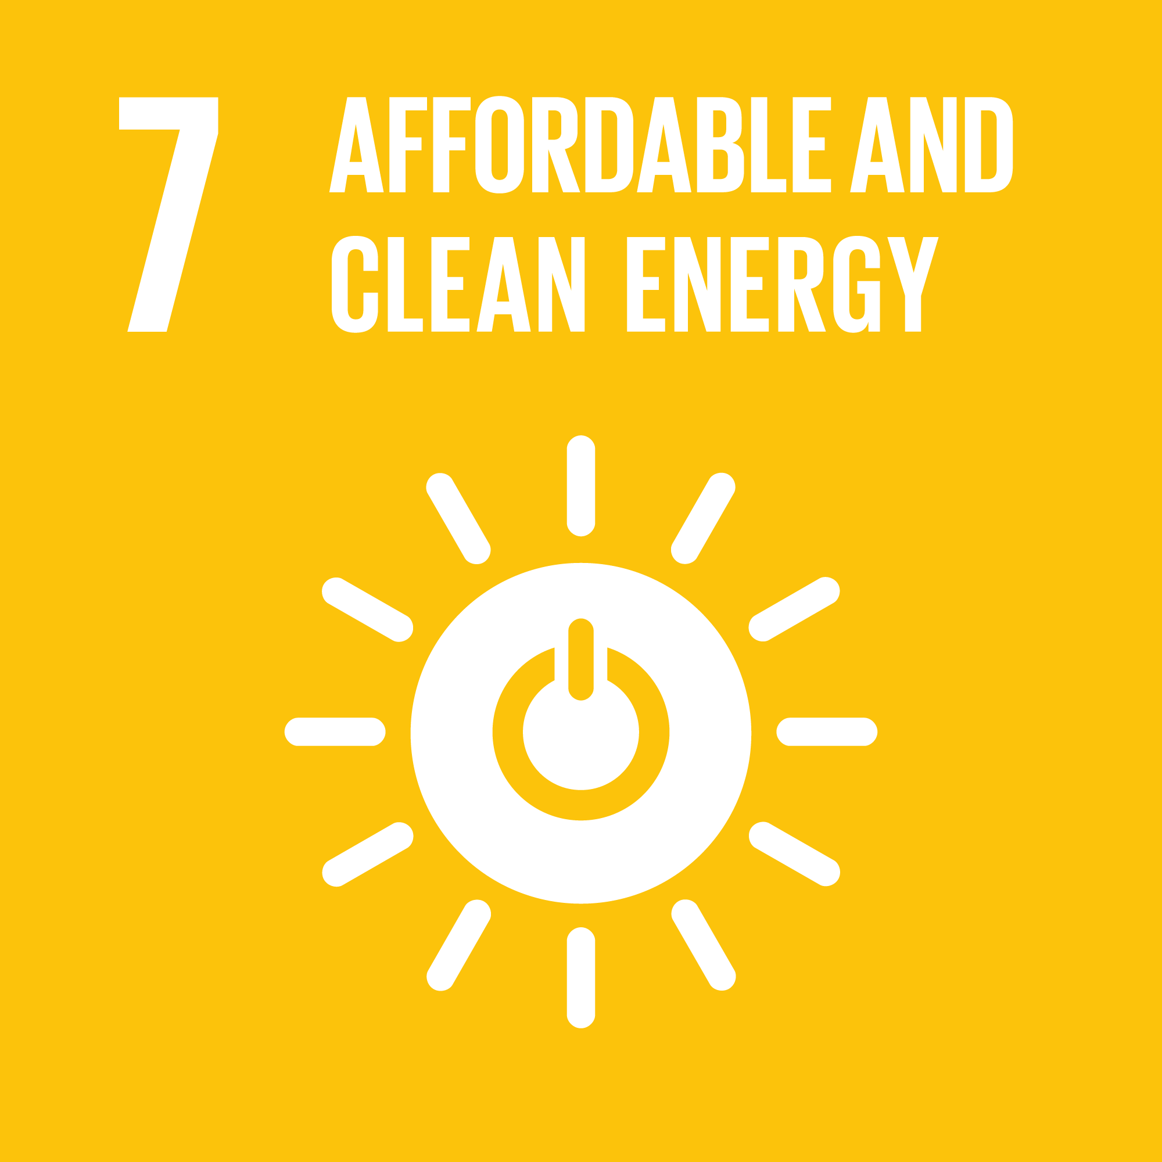
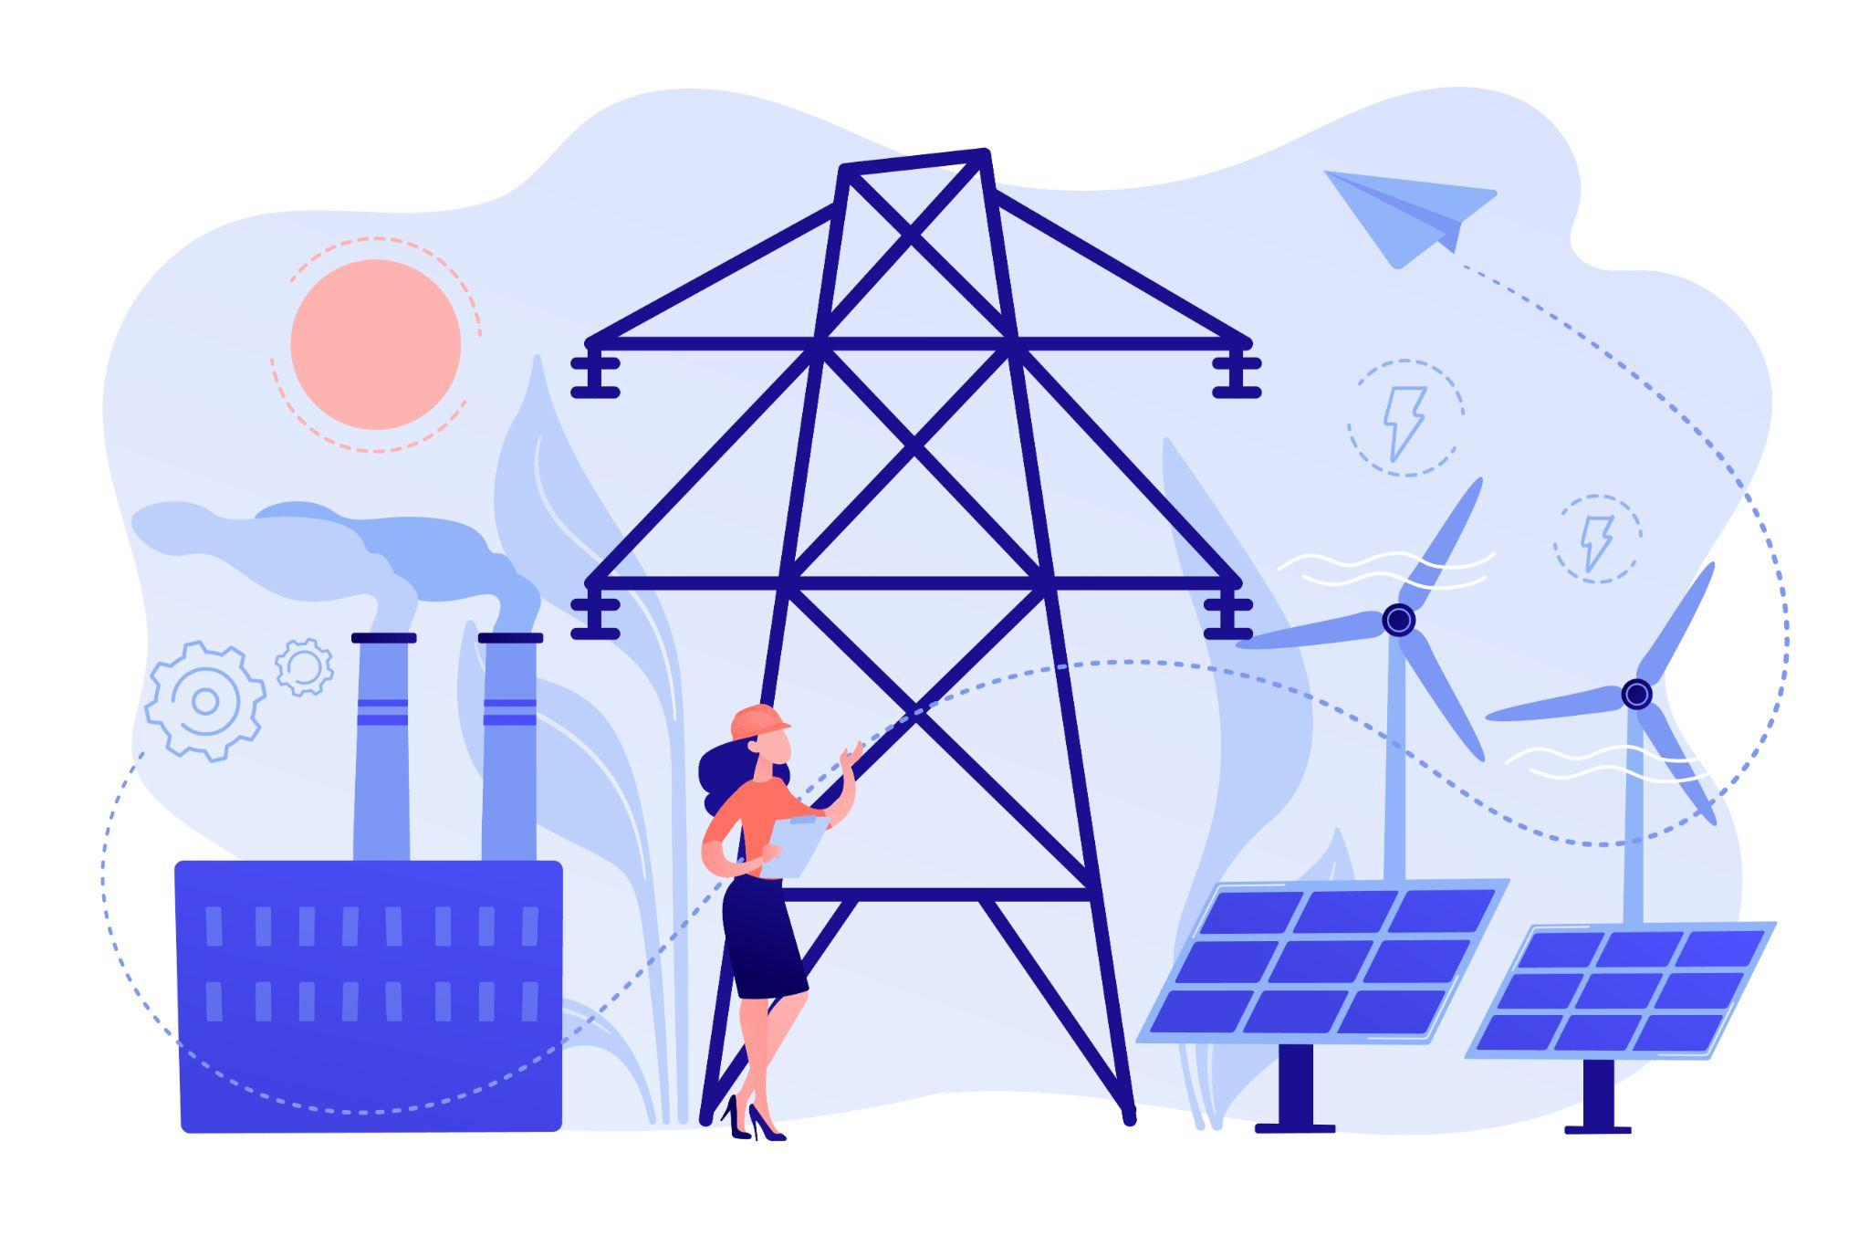
What powers daily life is often invisible until it fails!
Access Is the Starting Line
How Power Is Generated Changes Outcomes
Energy decides what is possible. Light after sunset. Functioning hospitals. Reliable communication.
For some, energy is assumed. For others, it is uncertain or absent.
Without access, development does not begin!
Energy sources shape systems over time.
Fossil fuels enabled growth.
They also created long-term costs and dependencies.
Renewable energy changes the structure:
Less exposure to fuel volatility
Local generation possibilities
Lower long-term environmental burden
Energy transitions are system problems, not technology problems.
Progress Depends on What Gets Built
Efficiency reduces demand quietly. Infrastructure locks in choices for decades.
Efficient buildings
Smarter grids
Modern equipment
Access to technology and investment
What keeps water systems working!
Economic, Societal, and Environmental Impacts of Available Energy Sources: A Review
World Energy Outlook 202

Slide 20
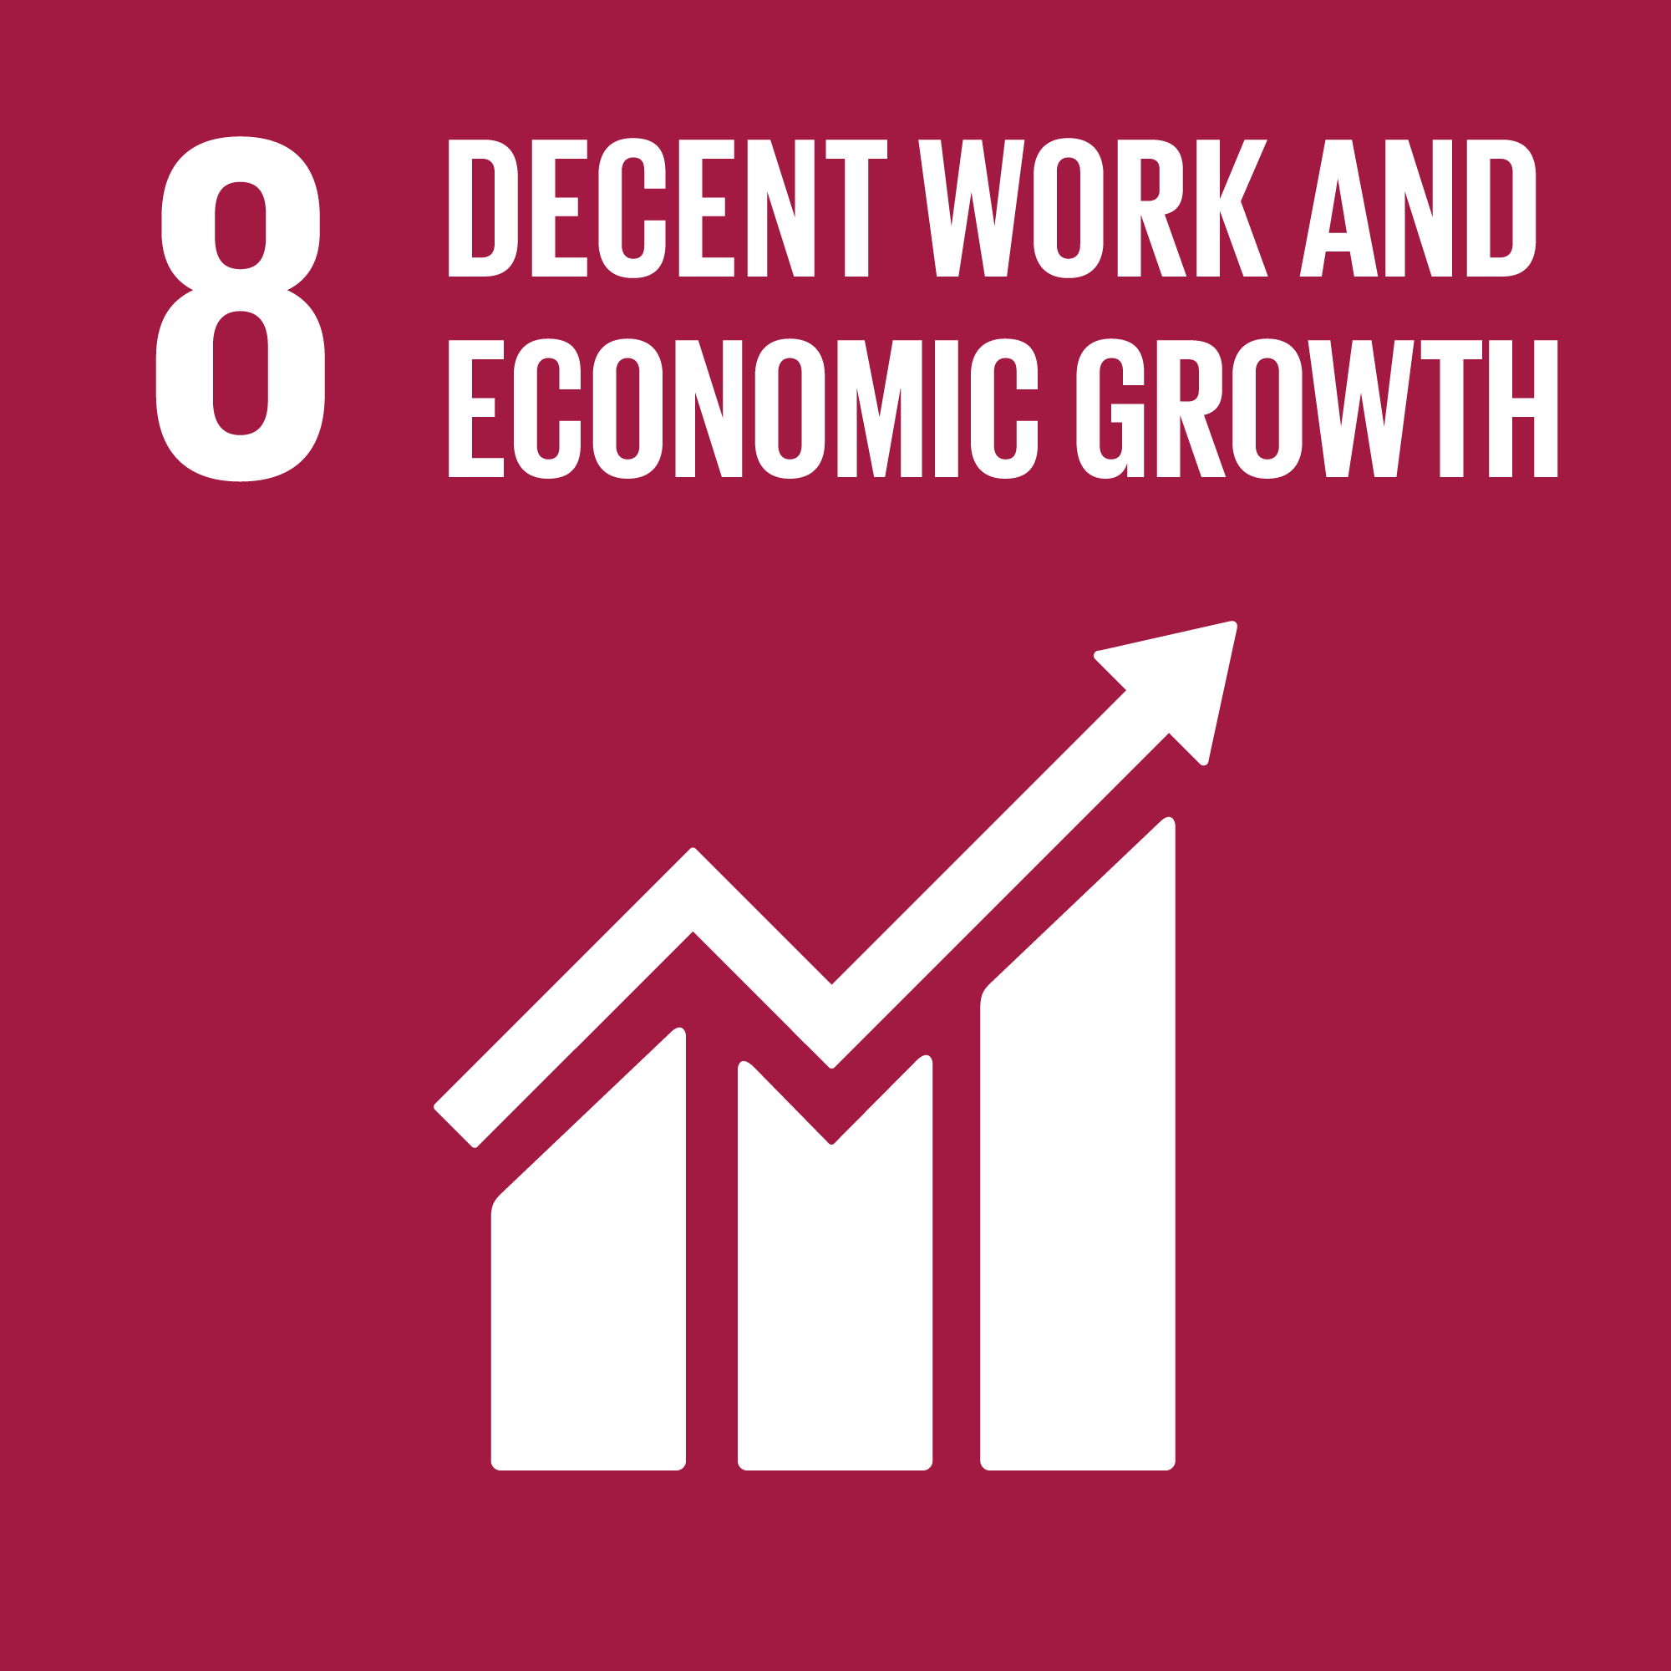

Economic systems shape how work is created and sustained.
Growth Defines the Envelope
Productivity Changes the Nature of Work
Economic growth sets the outer limits of what an economy can support.
It influences investment capacity, job availability, and public spending.
But growth alone is incomplete.
It does not explain:
Who gains access to work
Which sectors expand
How stable jobs remain over time
Those outcomes depend on structure, not scale.
Productivity increases when economies:
Diversify beyond a few sectors
Upgrade technology and processes
Invest in skills and innovation
Higher productivity enables:
More resilient enterprises
Better use of labour
Long-term competitiveness
Small and growing firms benefit when financial and formal systems are accessible.
Participation Requires Minimum Conditions
How participation is sustained!
What is economic growth? And why is it so important?
Outcomes of Meaningful Work in the Context of Indian Blue-collar Employees: The Moderating Role of Relational Identification and Organisation-based Self-esteem
Work depends on safe environments and predictable compensation. Formal participation expands when basic financial access exists.

Slide 21
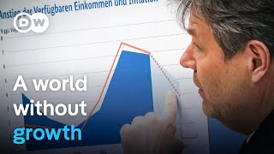

Slide 22
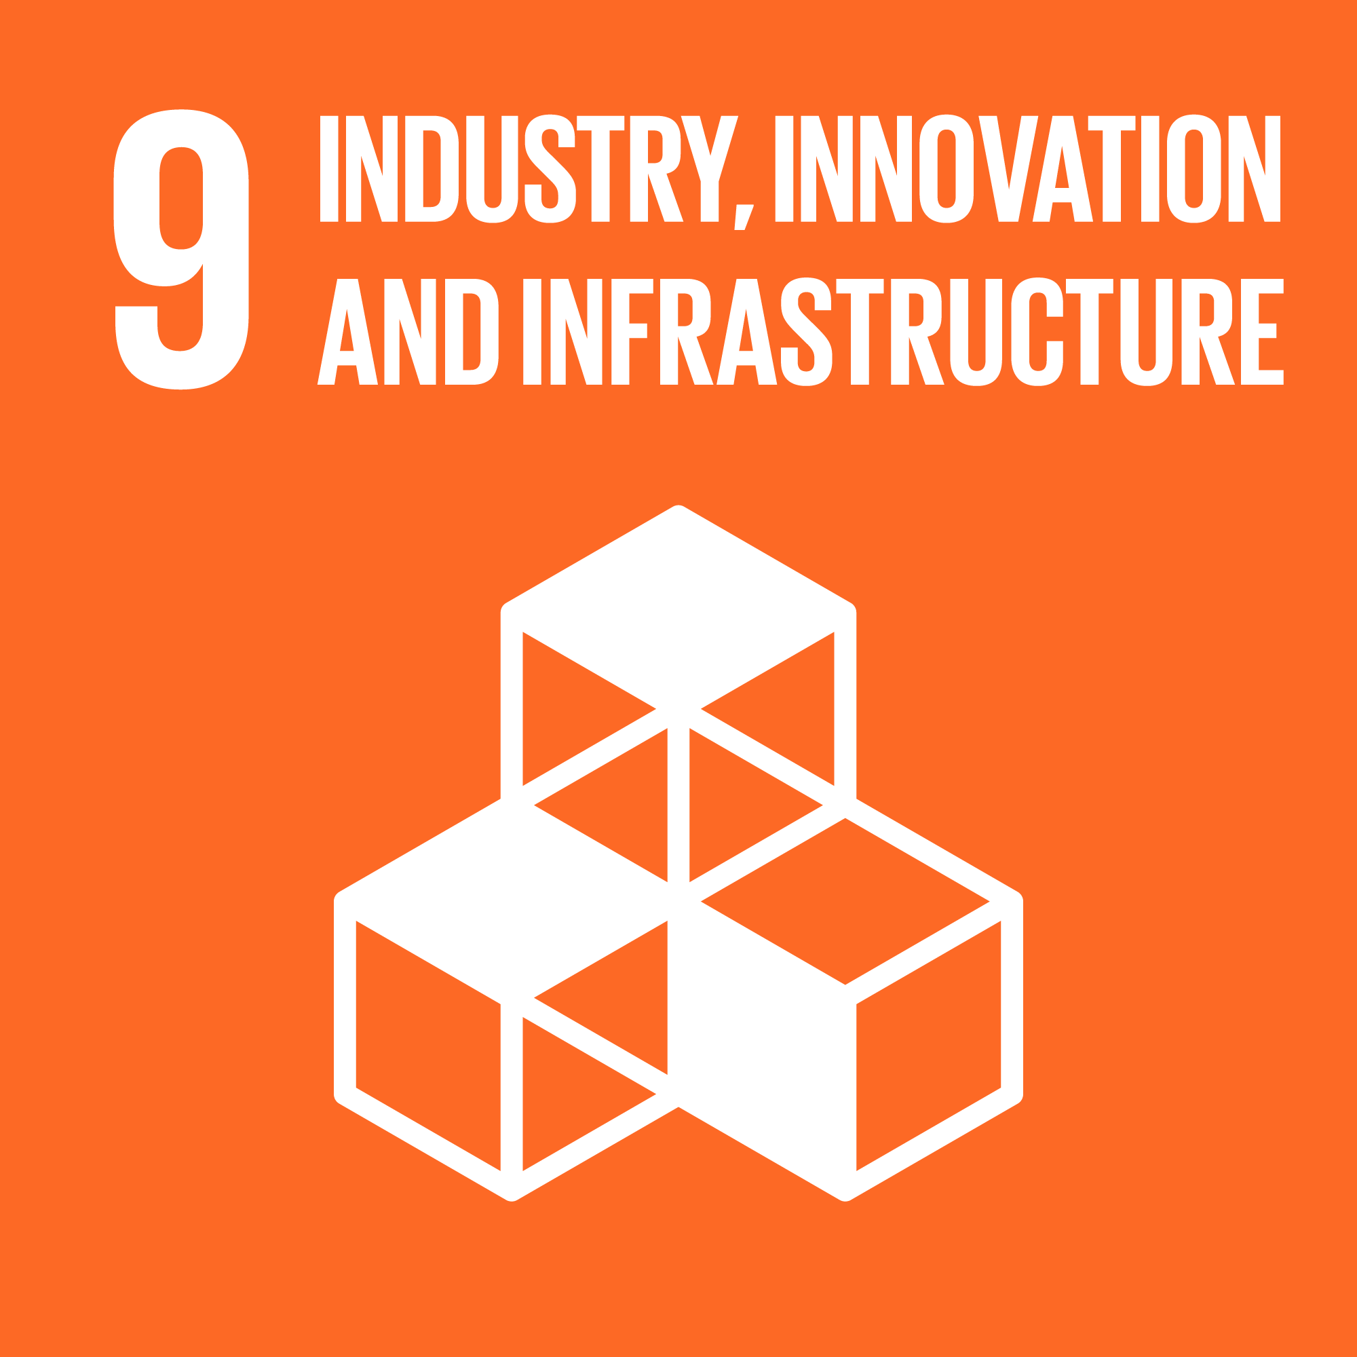
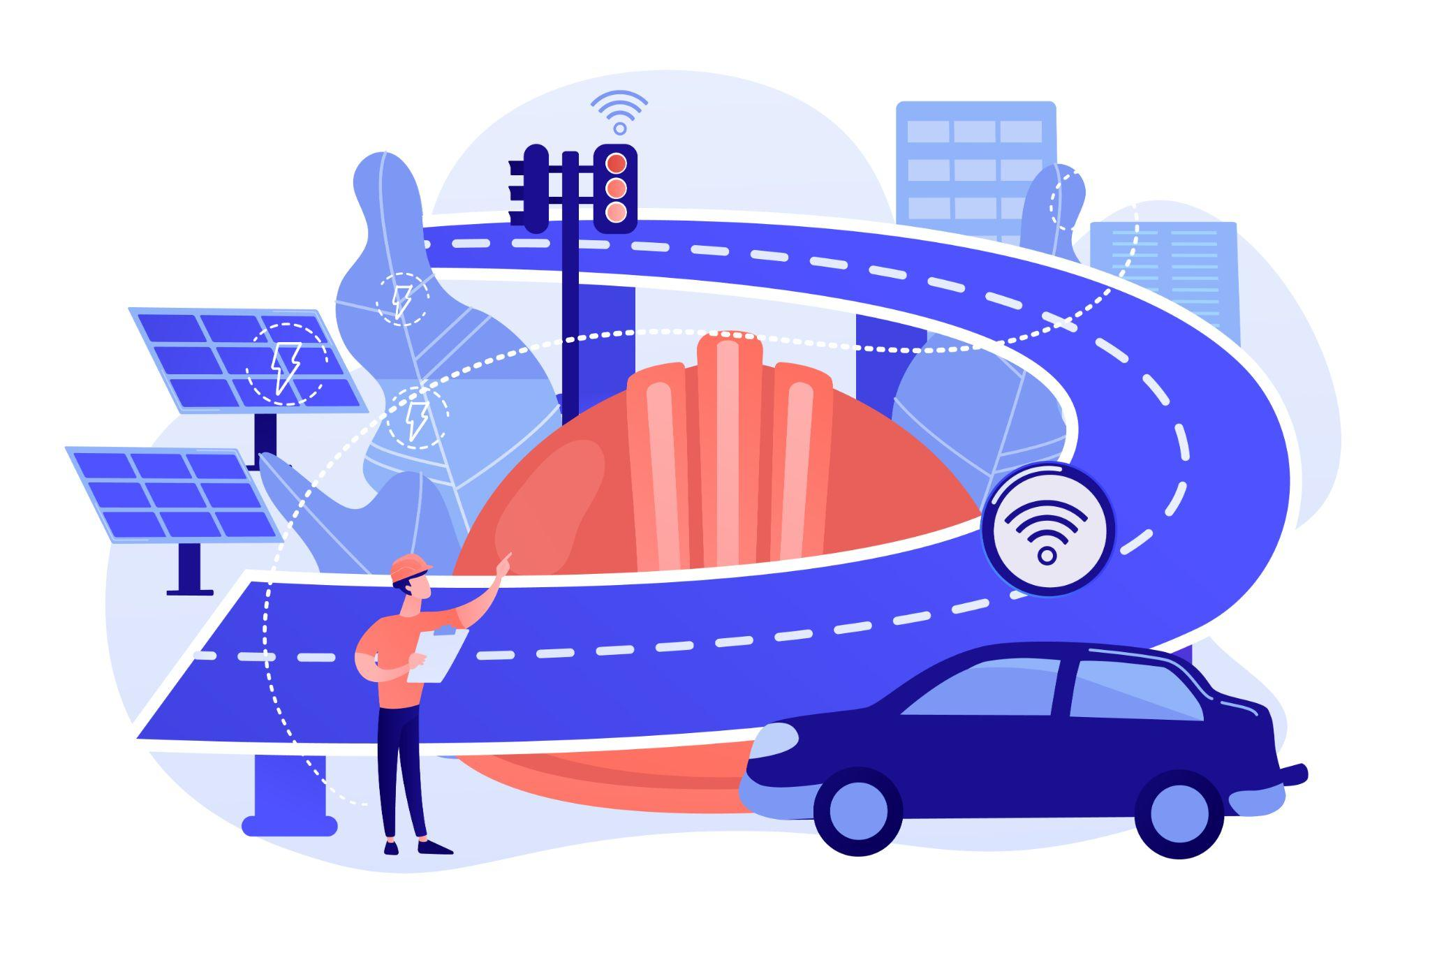
Long-term progress depends on systems that can scale and adapt.
Industry Scales What Works
Infrastructure Is the Base Layer
Industrial systems translate capability into output.
They rely on:
Reliable infrastructure
Technology adoption
Efficient production processes
Upgraded industry supports:
Higher productivity
Stable employment
Integration into global value chains
Resilience matters as much as scale.
Infrastructure enables everything that follows.
Transport, energy, communication, and digital networks decide how reliably economies function.
When infrastructure is missing or outdated, growth becomes uneven and fragile.
Well-built systems reduce friction across sectors.
Innovation Keeps Systems Relevant
From infrastructure to innovation!
Innovation allows systems to adapt rather than stagnate.
Research, skills, and access to technology shape this capacity. Without renewal, infrastructure and industry slowly lose relevance.
The important of Innovation and its Crucial Role in Growth, Survival and Success of Organizations
Infrastructure for impact, the work of system building | Marc Ventresca | TEDxOxbridge by Tedx Talks
The Future of Manufacturing and Industry 4.0

Slide 23
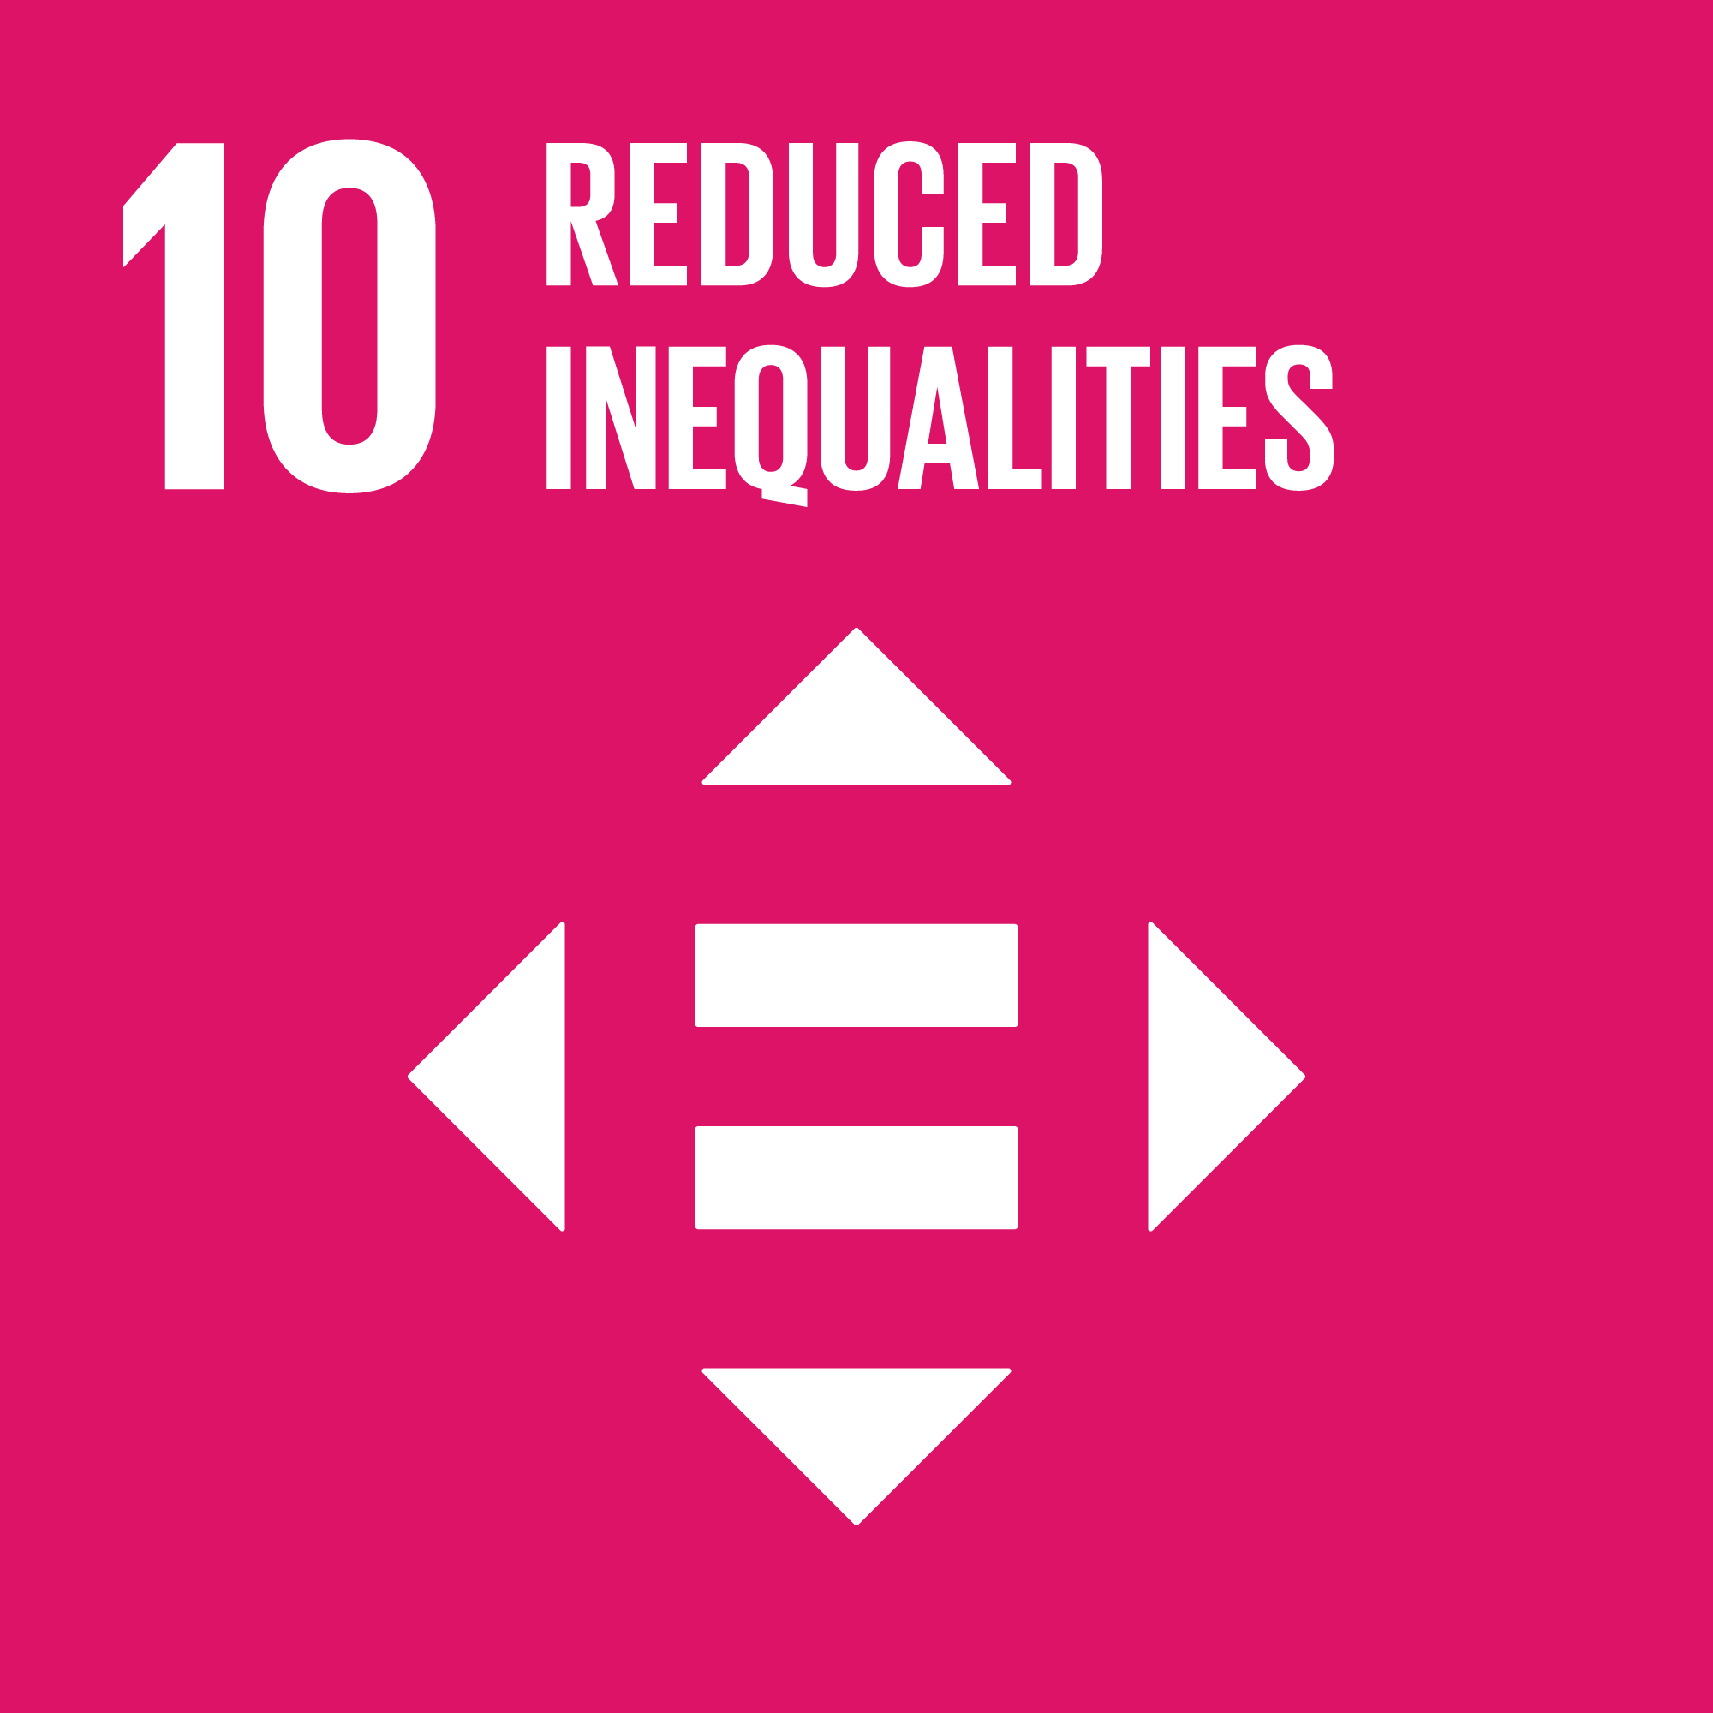
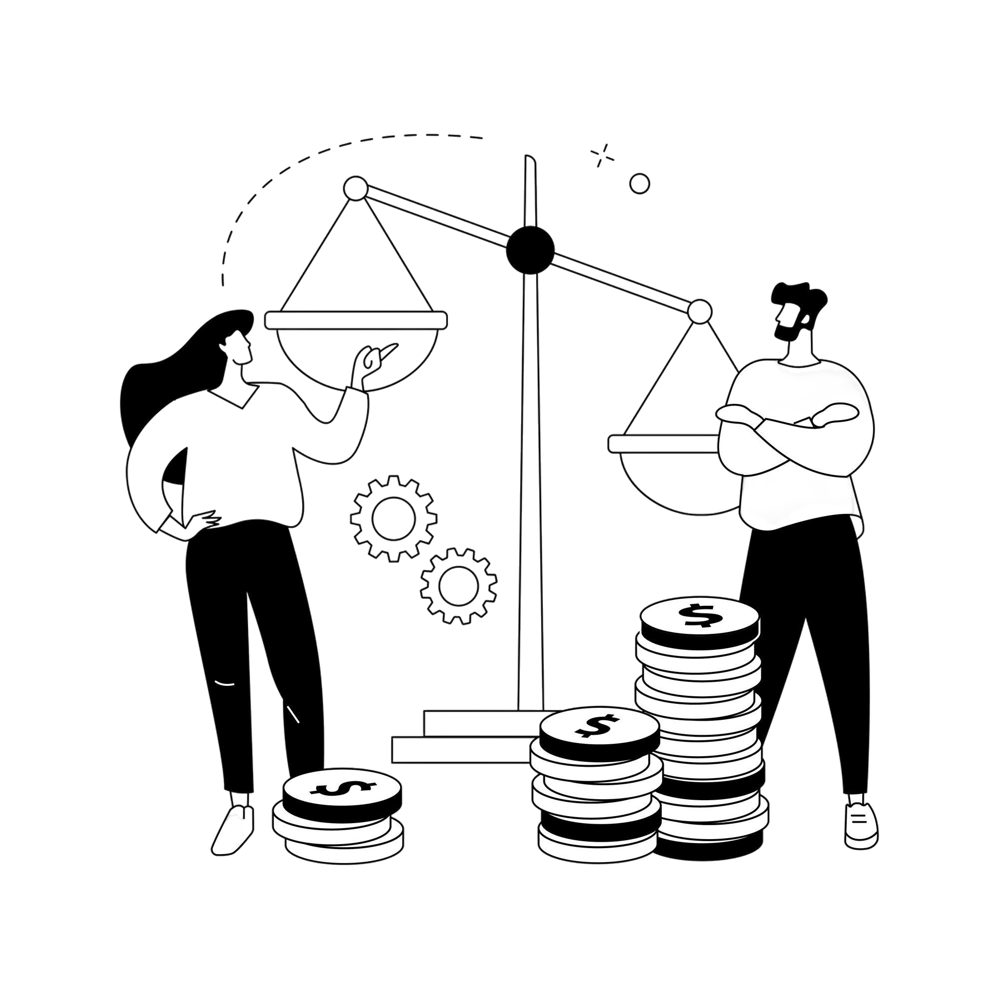
Inequality is not always visible.
But its effects are everywhere.
Inequality is not just about income!
WHY THIS MAKES PEOPLE UNCOMFORTABLE?
Inequality shows up in who gets access, who gets heard, and who gets left behind quietly.
It exists in education, healthcare, technology, mobility, opportunity, and dignity.
Two people can be equally talented, equally hardworking, and equally motivated yet experience very different outcomes because the starting lines were never the same.
Because inequality challenges merit myths. Because it forces us to notice privilege, not just disadvantage. Because it asks whether systems are fair, not just functional.
This is why conversations about inequality are postponed. And why they matter.
DID YOU KNOW?
Inequality affects social stability, health, and trust
High inequality weakens long-term economic growth
Unequal systems waste talent and human potential
If this made you pause, these explain why it matters!
What Is Social Inequality and Why Does it Matter? Evidence from Central and Eastern Europe
Beyond income: A multidimensional approach to tackling inequality

Slide 24
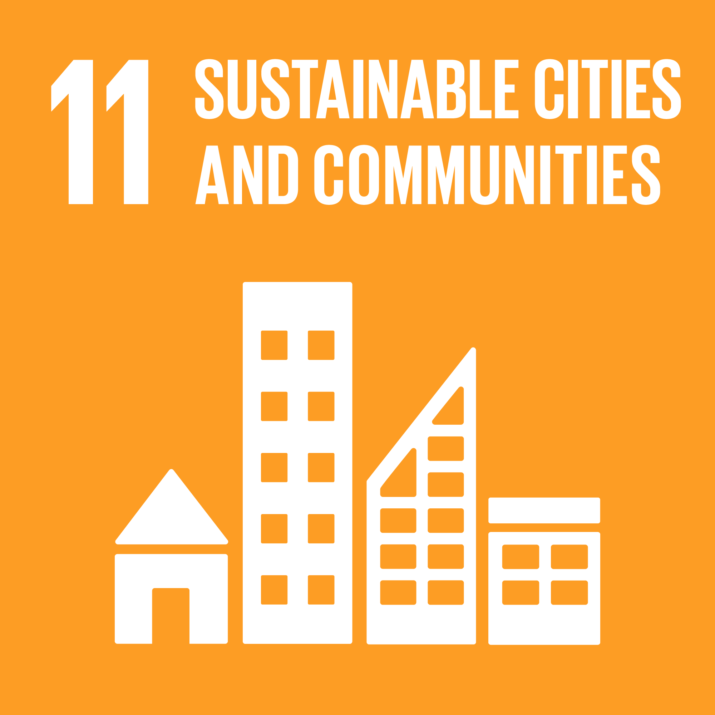
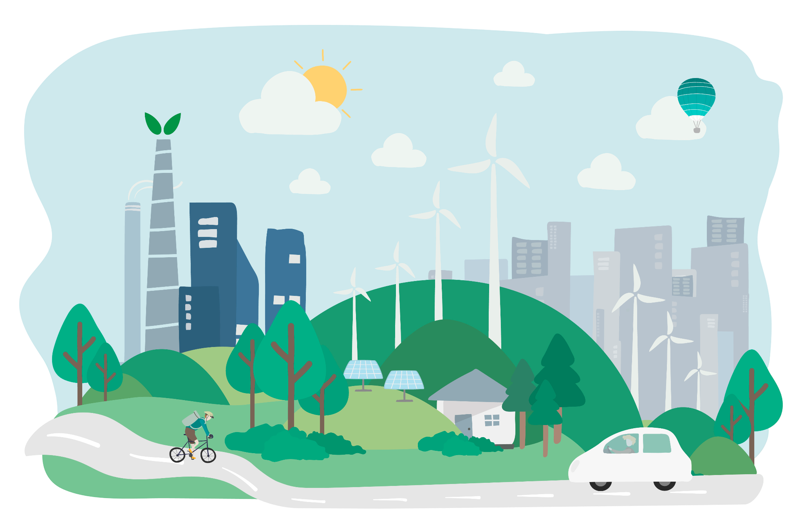
Cities are where sustainability succeeds or fails
More than half of humanity already lives in cities. Almost everyone else depends on them.
Cities concentrate:
People
Energy
Transport
Housing
Jobs
Waste
Opportunity
When cities are designed poorly, everyday life becomes harder:
long commutes, unsafe streets, polluted air, social isolation, rising costs.
This goal shows up in daily life more than you think
Sustainable cities are felt, not announced.
They show up in:
Whether you can walk safely at night
Whether public transport is reliable
Whether housing is affordable
Whether green spaces exist nearby
Whether communities feel inclusive or divided
SDG 11 asks a simple but demanding question:
Are our cities designed for people, or are people expected to adapt endlessly to poor design?
Here’s more about it!
Sustainable Cities: Crash Course Geography by CrashCourse
A Visual Analysis of the Development and Trends of Sustainable Communities: A Survey on Technology, User Needs, and Design

Slide 25
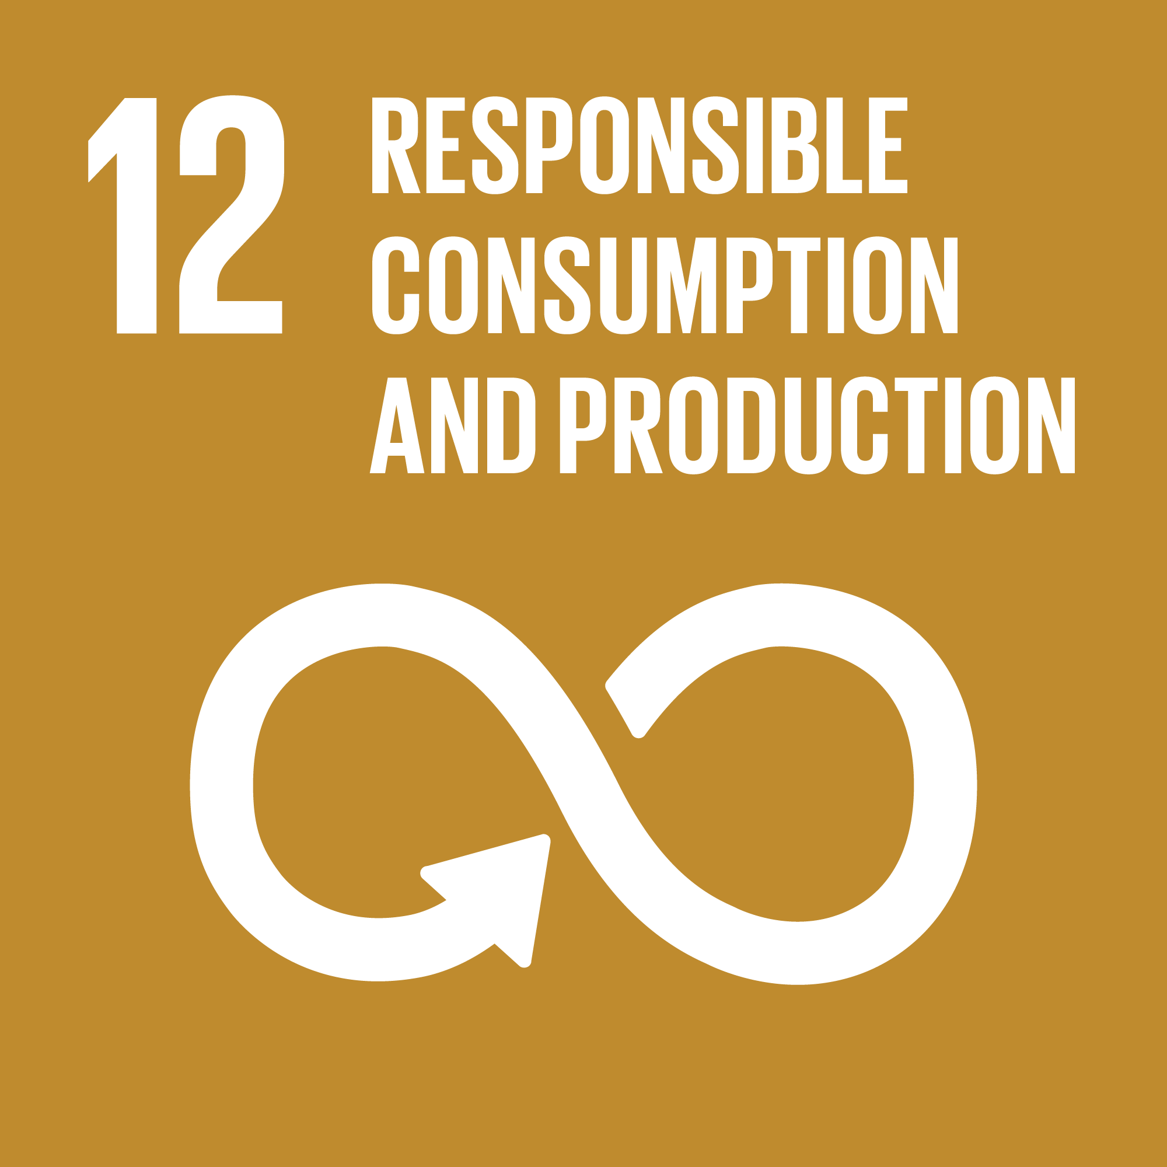

The most personal sustainability challenge. And the most avoided one.
Why this goal is uncomfortable?
Because it talks about our habits, not distant systems
Because it questions convenience, not intentions
Because it asks “how much is enough?” in a culture that rewards “more”
SDG 12 is not about perfection
Why students matter here?
Responsible Consumption and Production does not ask people to stop consuming.
It asks them to consume consciously.
It asks whether products are:
Designed to last
Used fully
Reused where possible
Disposed responsibly
Students shape consumption patterns early.
Hostel life.
Fast fashion.
Electronics upgrades.
Food waste.
Convenience-first choices.
Know more:
UN Sustainable Development Goals - DEEP DIVE by Hippy In A Suit
Coupling responsible consumption and sustainable production using consumers’ green purchase behaviour

Slide 26
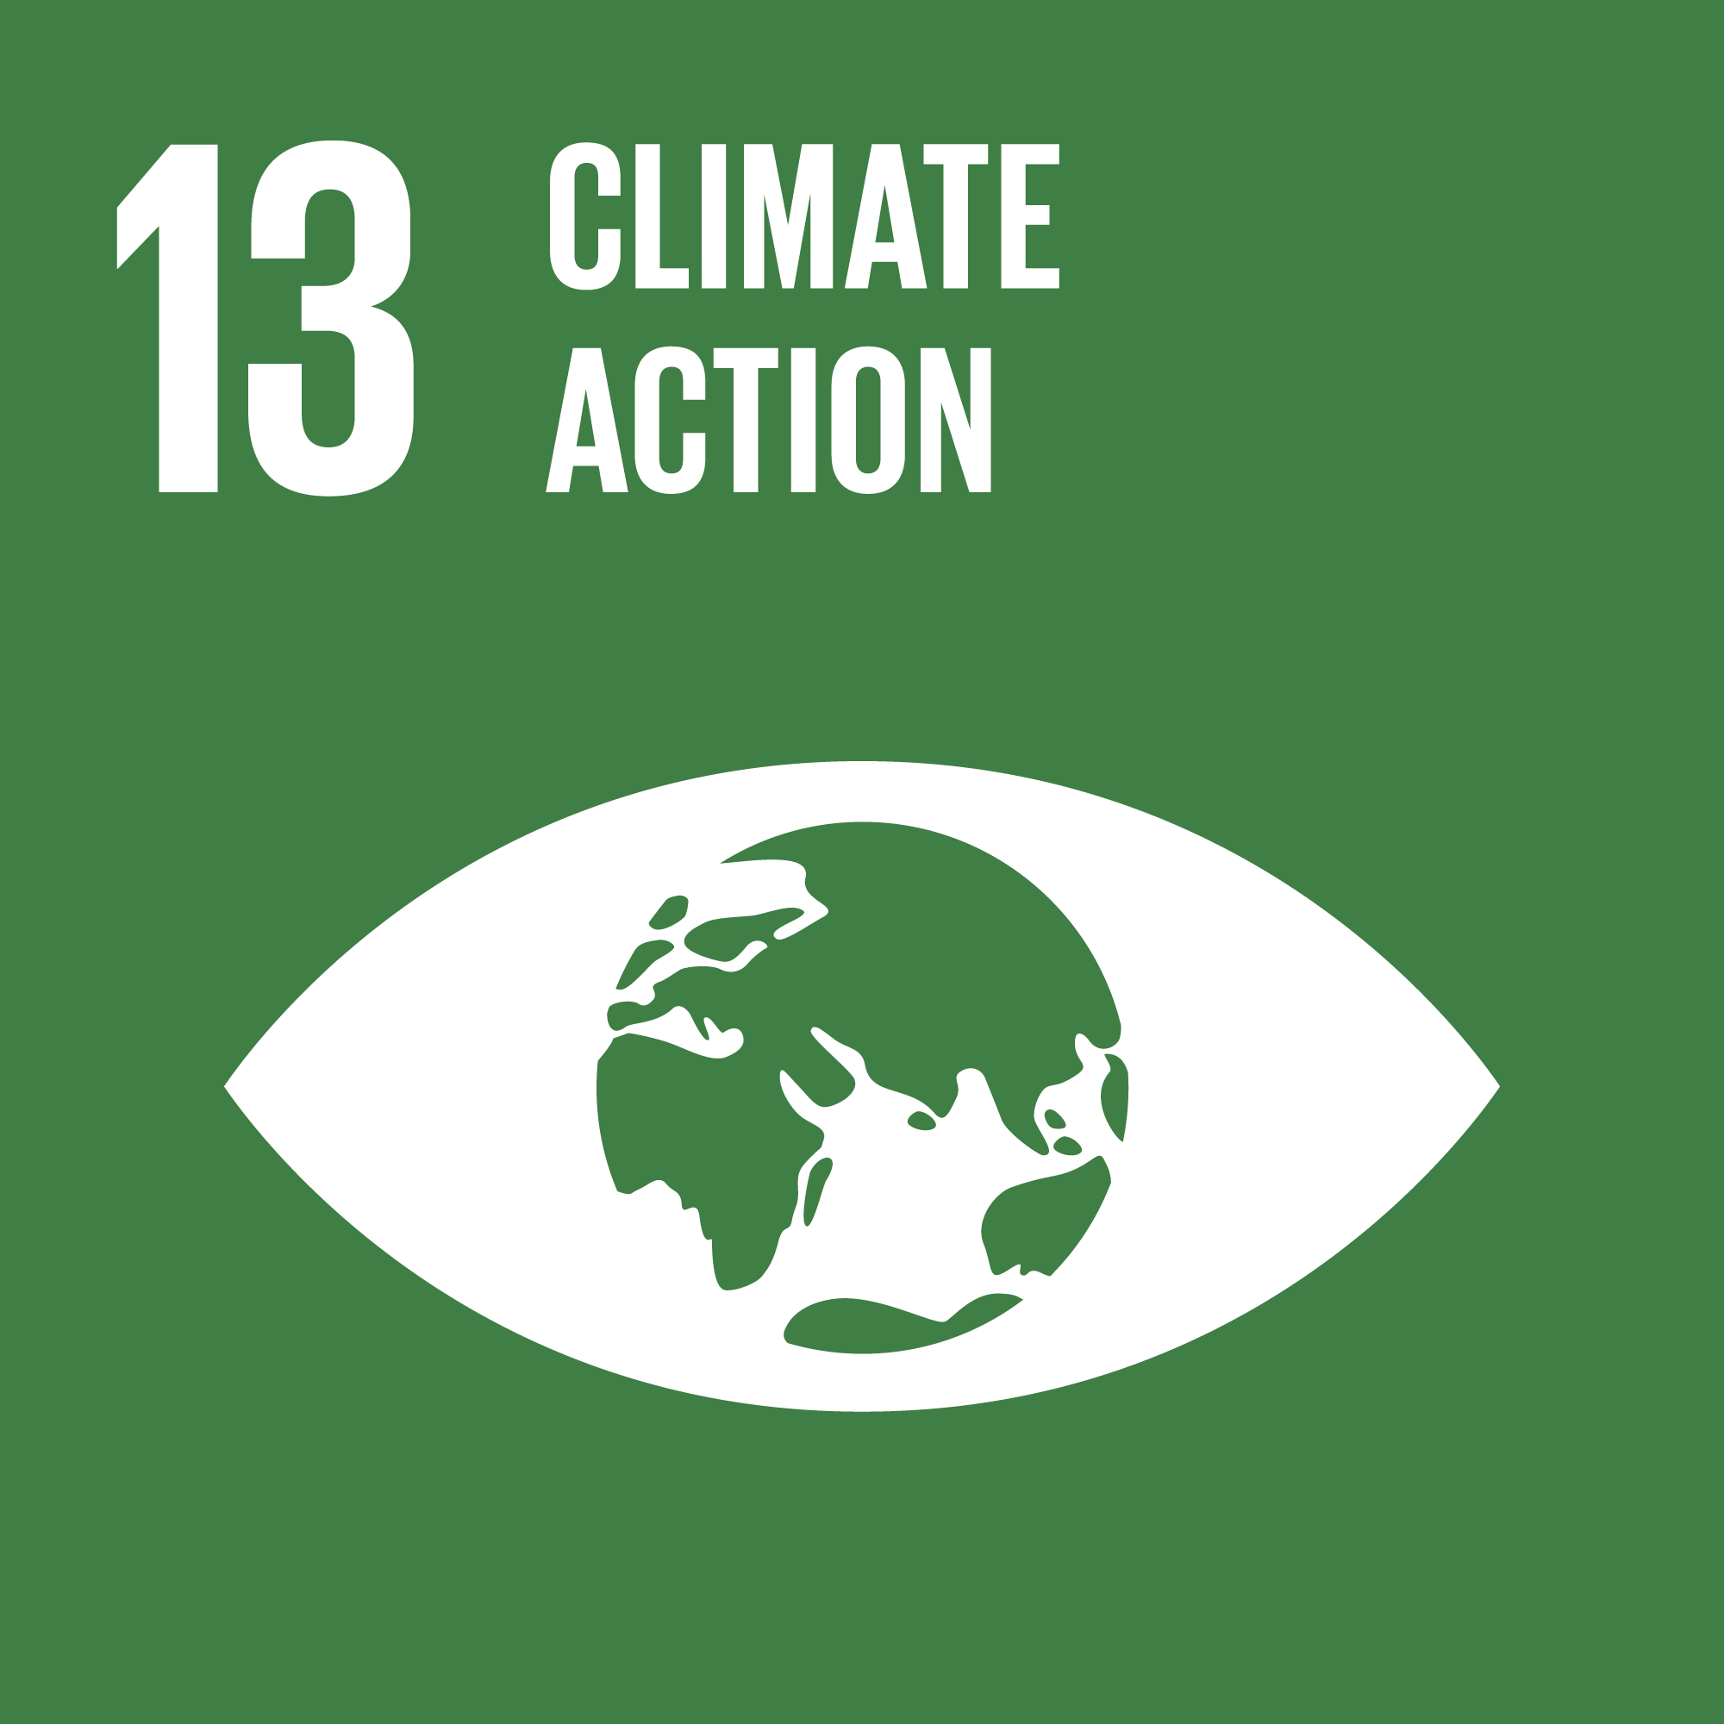
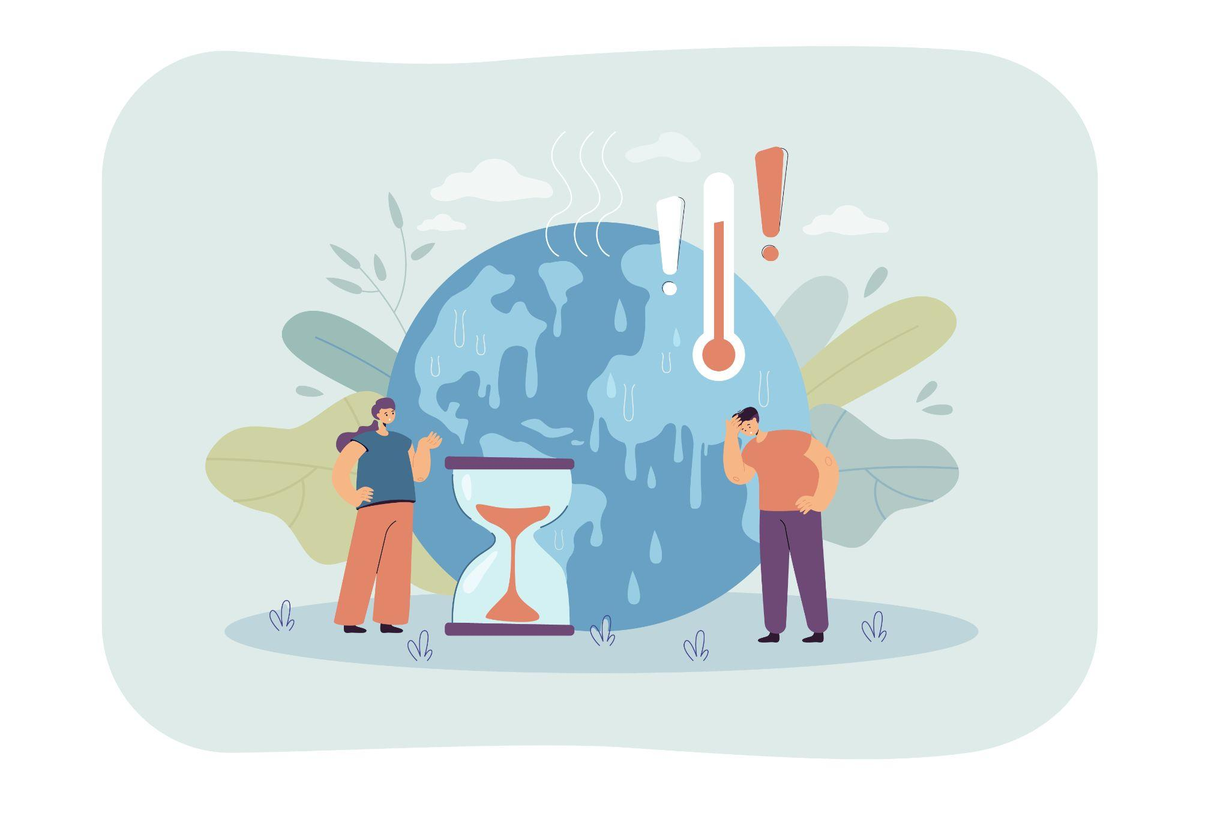
The question is not awareness. It is readiness.
Resilience Is Built Before Disasters
Action Happens Through Planning
Climate impacts become disasters when systems are unprepared.
Resilience depends on:
Early warning systems
Risk-aware infrastructure
Local response capacity
Planning for extremes, not averages
Adaptation reduces damage before it appears. Response works only when preparation exists.
Climate action is effective when it is embedded in decisions.
This includes:
Integrating climate risk into policy and development plans
Aligning infrastructure, energy, and land use choices
Treating climate measures as part of long-term growth
When planning ignores climate, costs reappear later as losses.
Capacity Turns Intent Into Action
Action depends on knowledge, institutions, and coordination.
Education, financing, and shared frameworks enable countries and communities to act. Capacity determines whether commitments become outcomes.
What enables effective climate response!
State of Nature and Climate 2025 Centre for Nature and Climate
State of Climate Action 2025
Ecuador’s Cocoa Boom Shows How Climate Change Is Redrawing Agriculture

Slide 27


Slide 28
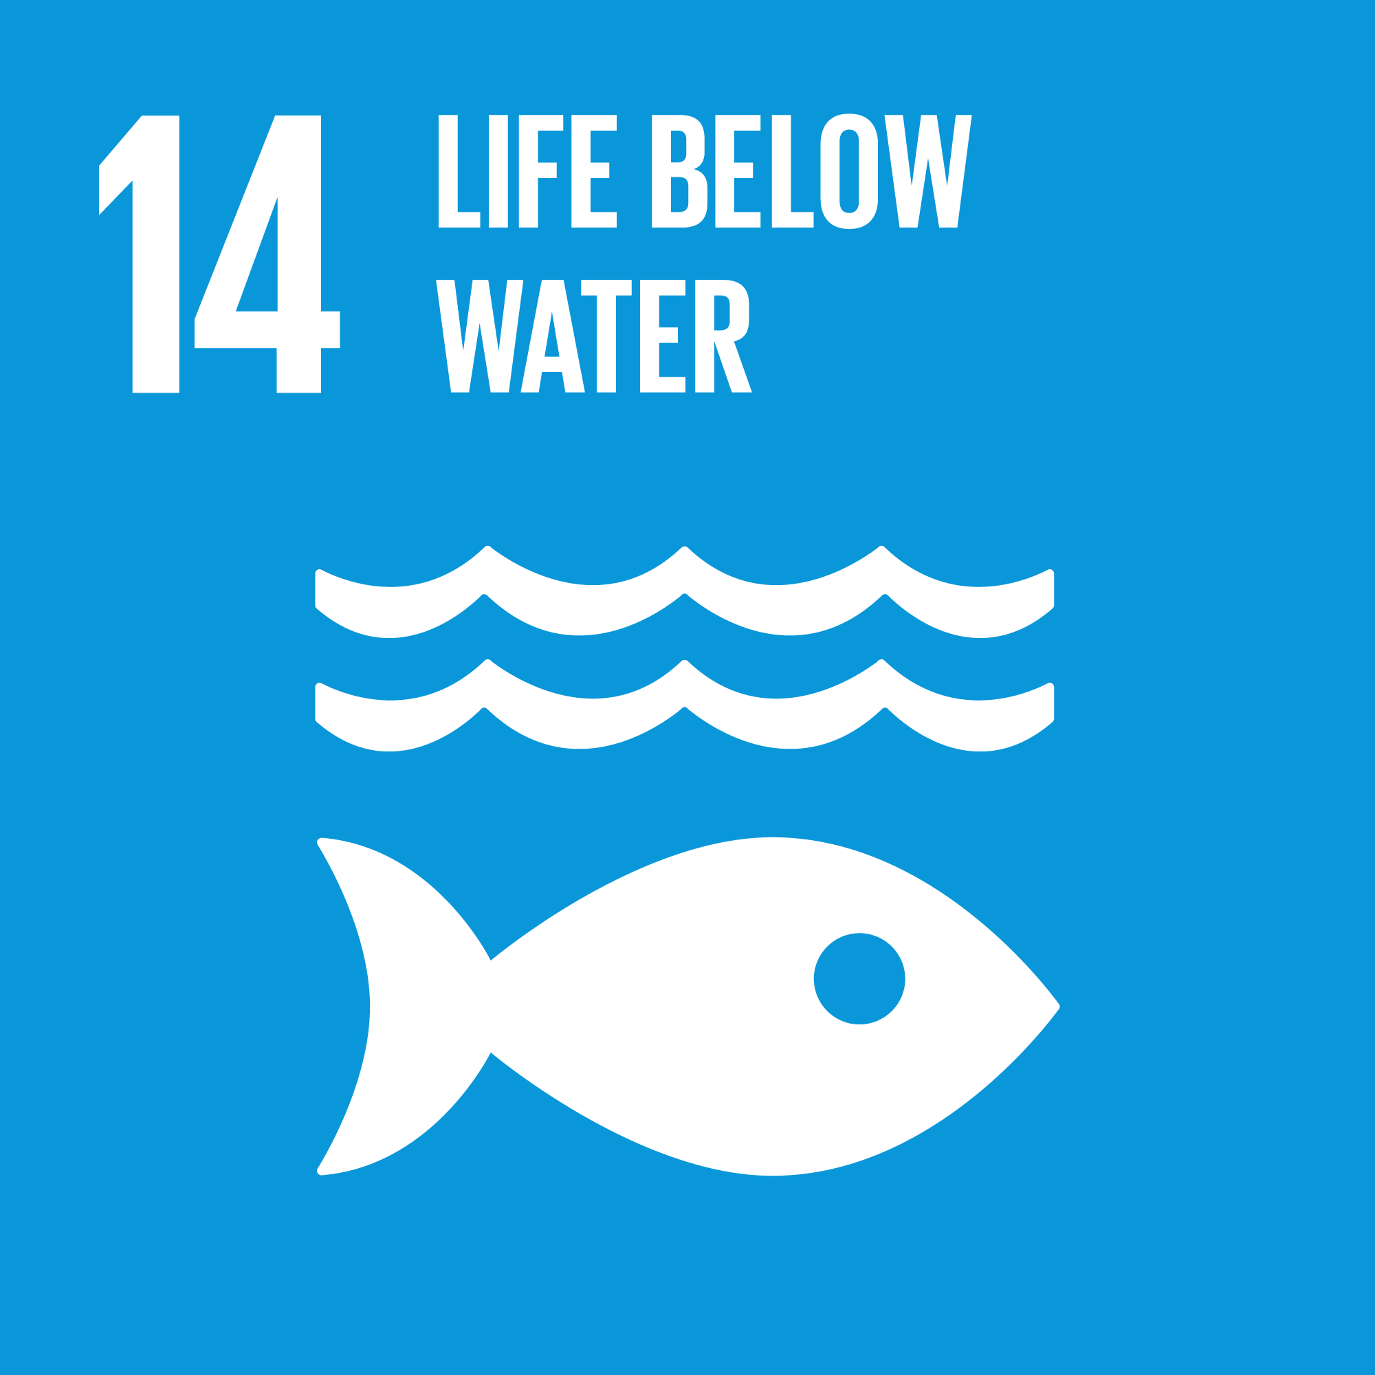
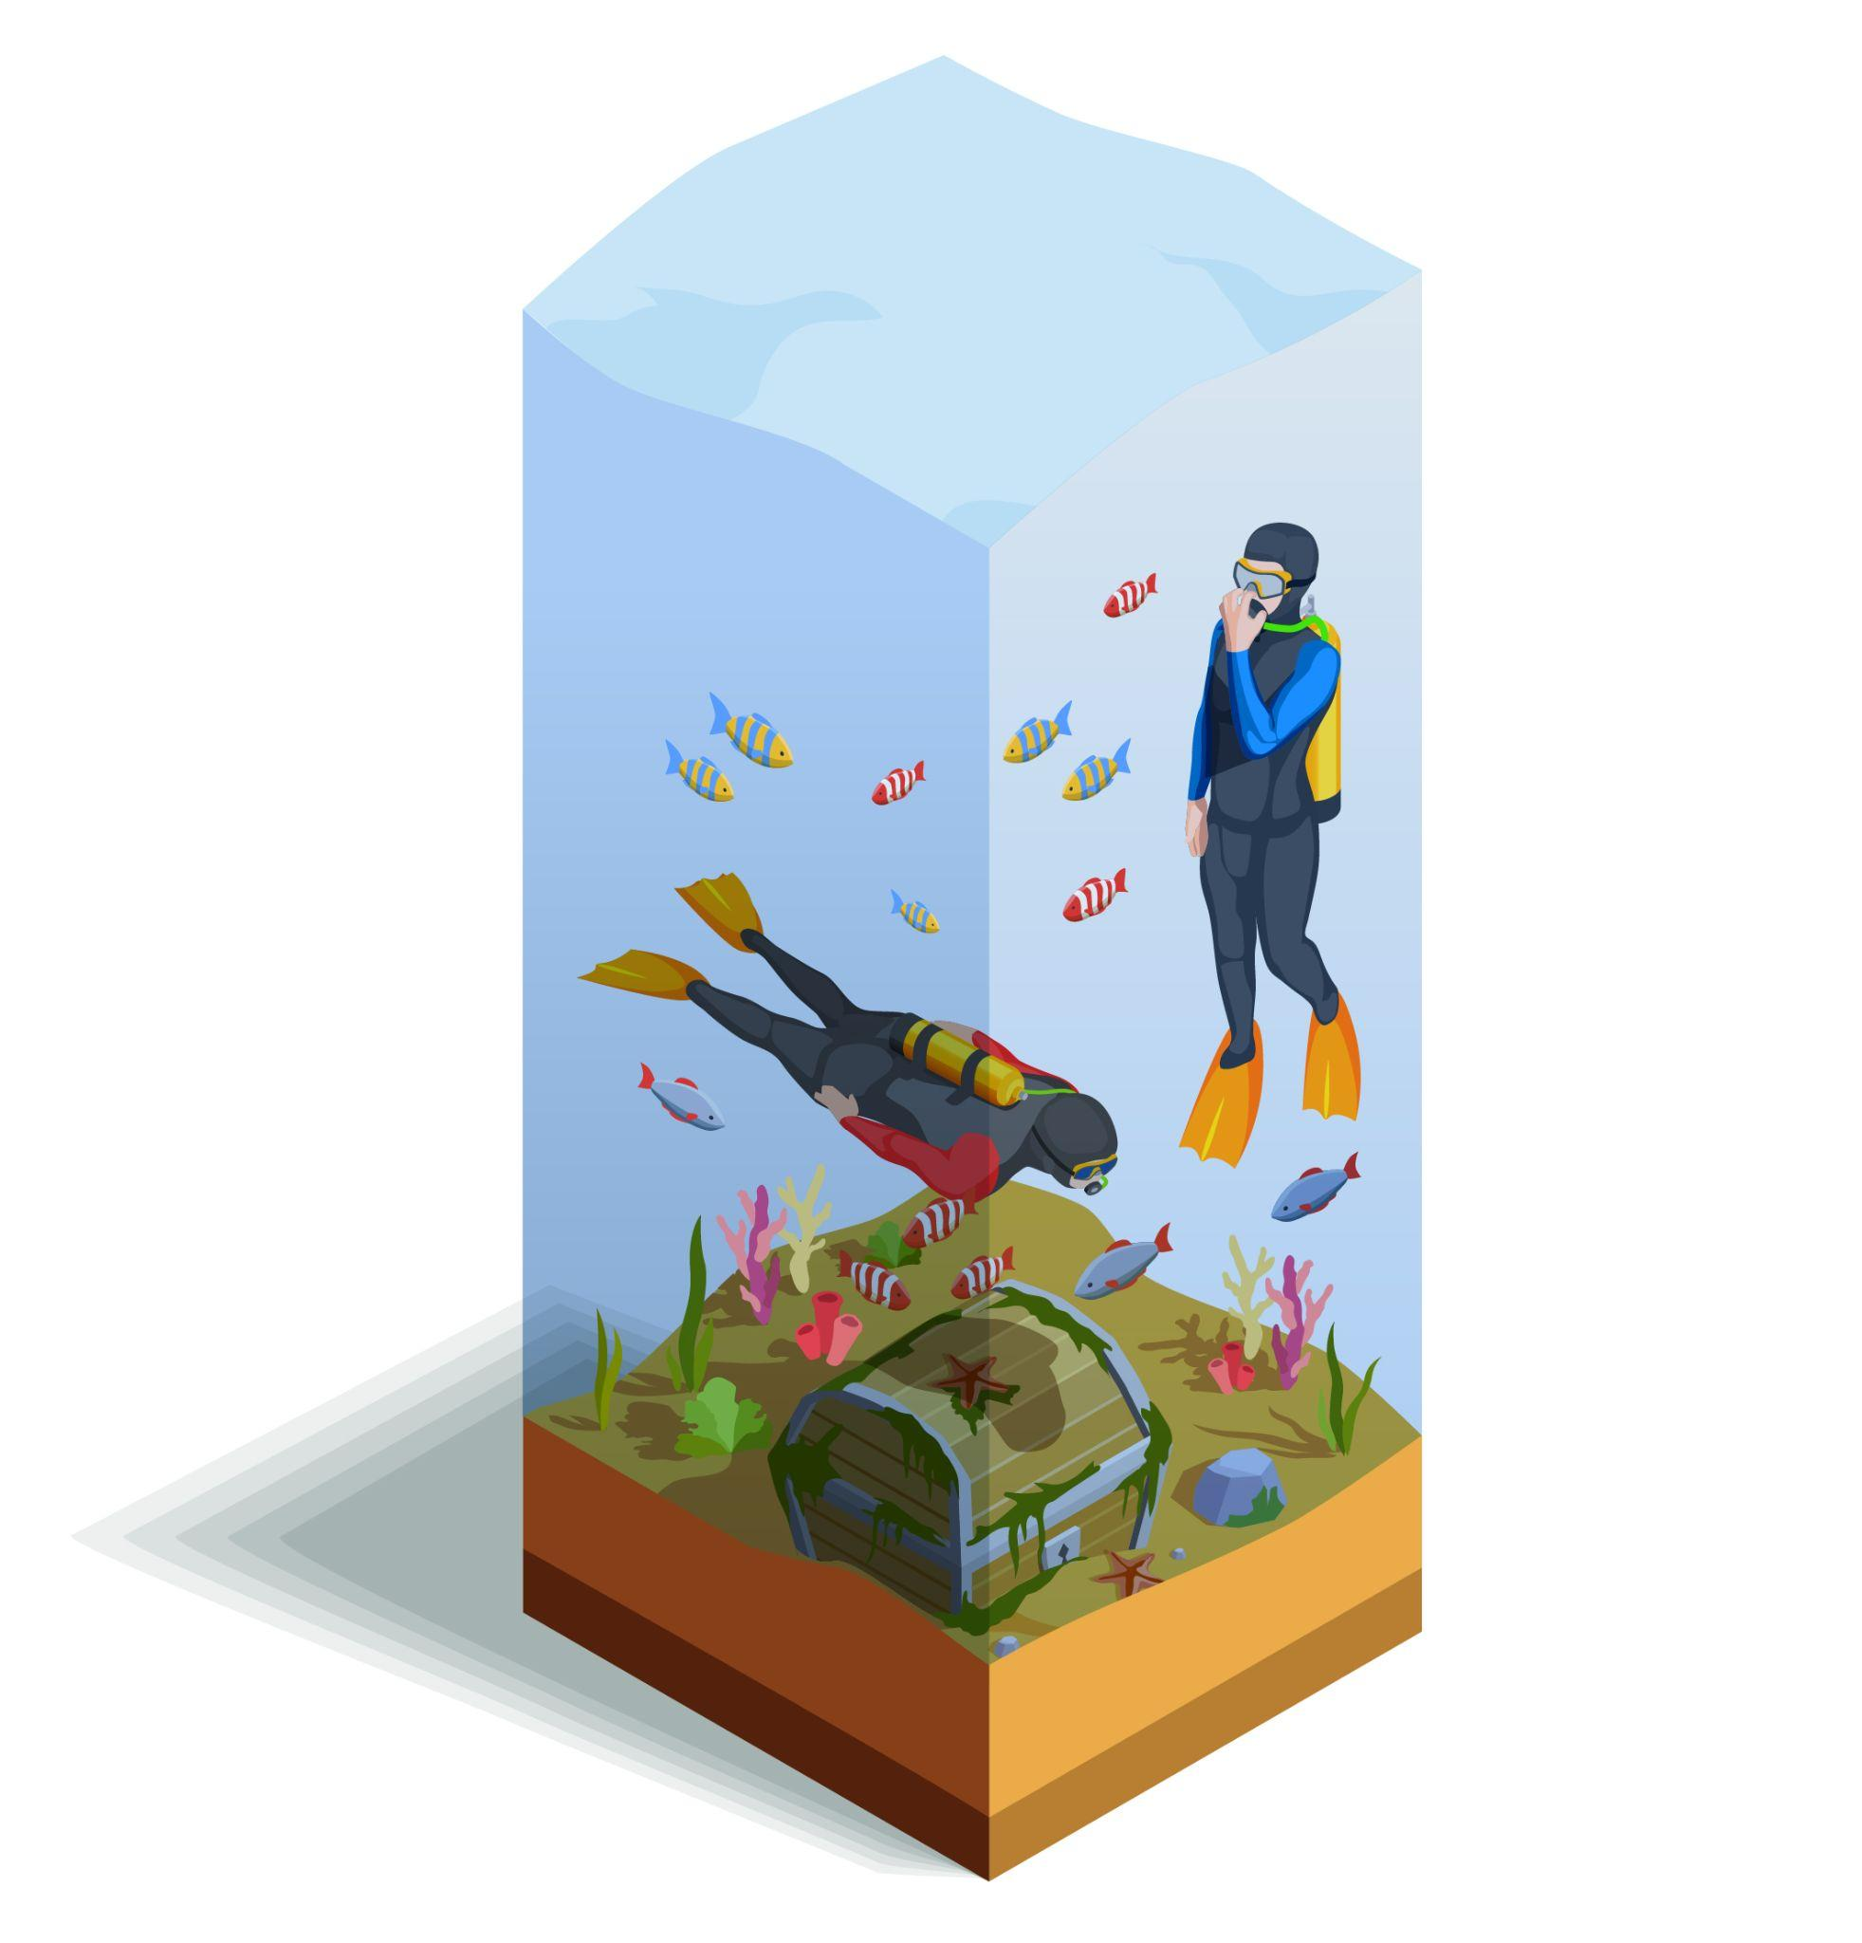
Ocean health depends on how human systems interact with it.
Most Marine Damage Starts on Land
Sustainable Use Is a Management Problem
Marine pollution is rarely accidental. It accumulates through everyday systems.
Major sources include:
Waste and plastic leakage
Nutrient runoff from agriculture
Untreated urban discharge
Reducing pollution requires upstream control. Cleanup alone does not reverse damage.
Oceans remain productive when use is regulated.
This depends on:
Science-based fishing limits
Ending illegal and unreported harvesting
Protecting critical habitats and coastal zones
Subsidies and incentives matter. When misaligned, they accelerate depletion.
Conservation works best when ecosystems are allowed to recover.
Knowledge, Law, and Access Enable Protection
Ocean protection relies on data, research, and monitoring.
International law provides a shared framework for use and conservation.
Small-scale fishers benefit when access and markets are fair.
What keeps water systems working!
Life Below Water: The Arrival of a New Species - Narrated by Morgan Freeman

Slide 29
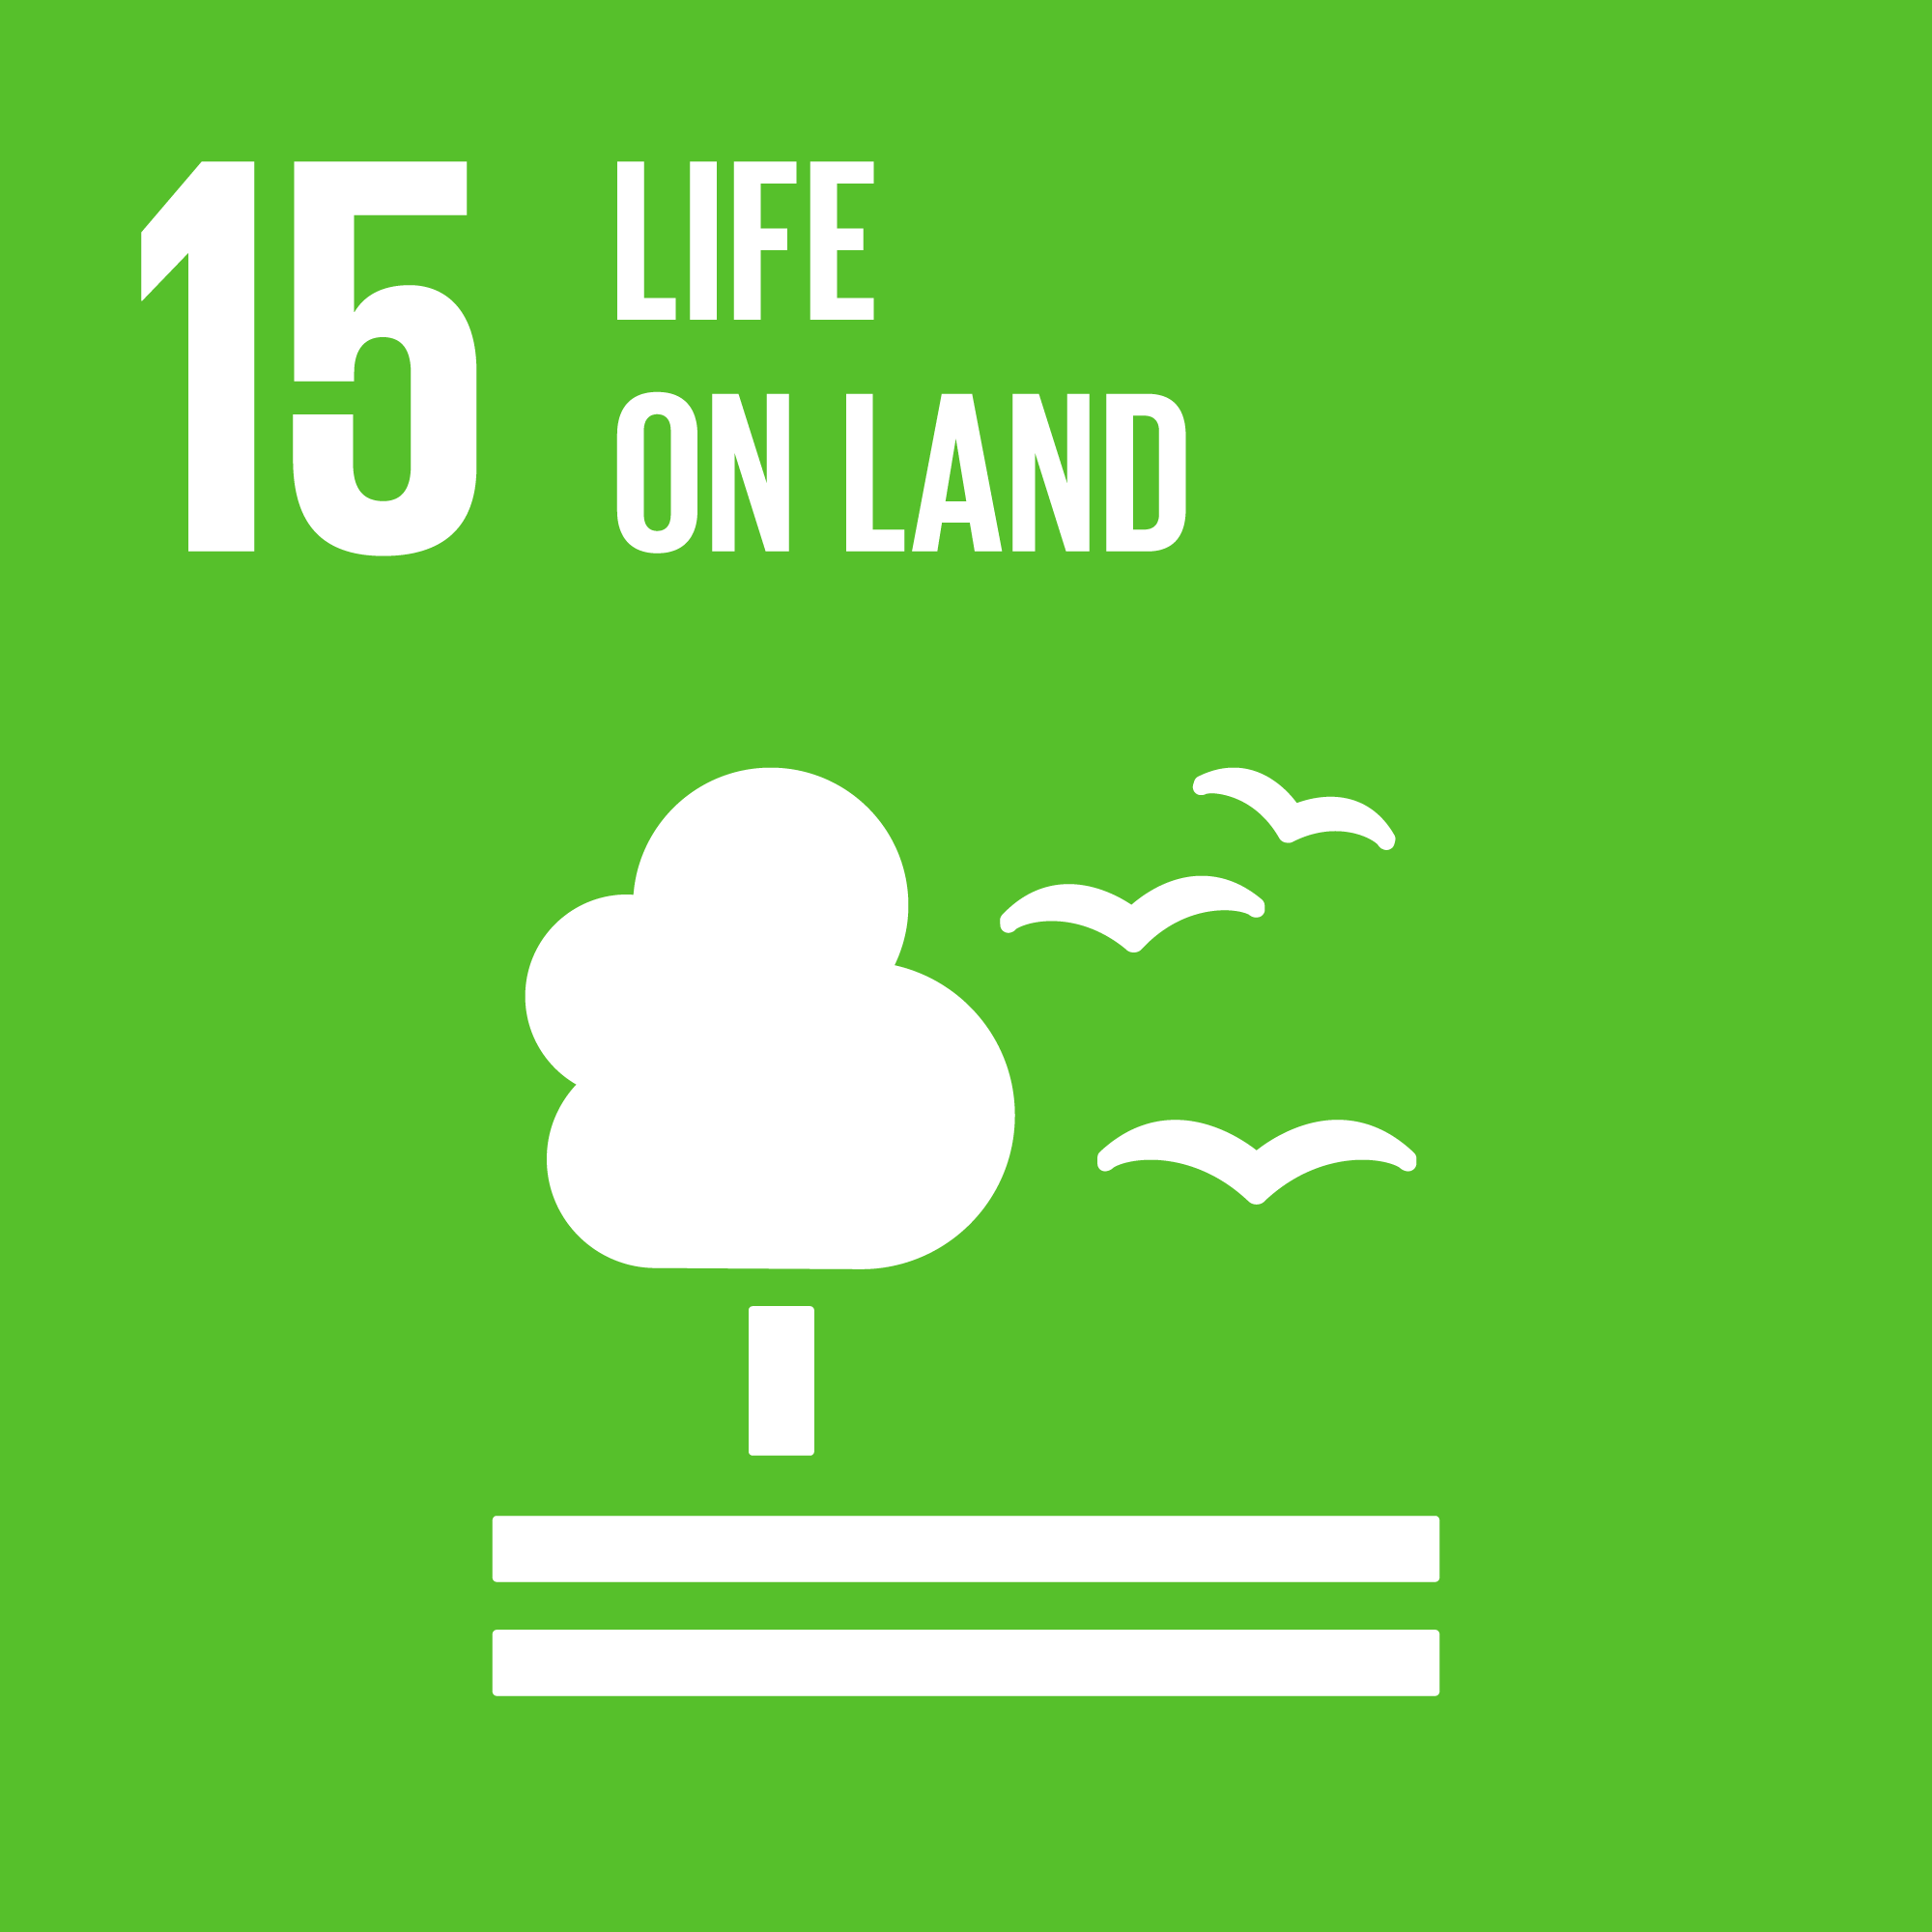

Land systems sustain life when they are managed, not exhausted!
Ecosystems Are Infrastructure
Degradation Is Preventable
Forests, wetlands, soils, mountains, and freshwater systems provide services that economies depend on.
They regulate water, support food systems, stabilize climate, and sustain biodiversity.
When these systems degrade, recovery is slow and costly.
Protection and restoration maintain long-term capacity.
Land systems degrade when pressures accumulate over time.
Key risks include:
Deforestation and land conversion
Soil erosion and desertification
Habitat loss and species decline
Invasive species disrupting balance
Once thresholds are crossed, recovery slows significantly.
Science-based land use, protected areas, and restoration planning reduce long-term loss.
Protection Requires Governance and Incentives
Planning and enforcement determine protection
Financing enables conservation and restoration
Local livelihoods strengthen when incentives align
What protects biodiversity!
Life on land: progress, outcomes and future directions to achieve the targets of SDG 15
Preserving biodiversity by protecting forests
SDG 15 goals off track: 'Life on land' under threat

Slide 30


Stable societies rely on systems that prevent harm and resolve conflict.
Justice Depends on Access and Enforcement
Violence Declines When Systems Intervene Early
Rule of law functions when:
Laws apply consistently
Justice systems are accessible
Organized crime and illicit flows are constrained
Corruption and bribery weaken enforcement. Transparency strengthens legitimacy.
Justice systems matter most when they are ordinary, not exceptional.
Violence is not random. It emerges where protection, oversight, and accountability are weak.
Reducing harm depends on:
Prevention, not reaction
Protection of vulnerable groups, especially children
Institutions that act before violence escalates
Safety improves when systems are predictable.
Trust Is Built Through Institutions
What makes governance work?
Effective institutions are accountable and inclusive. Participation, legal identity, and access to information enable trust.
Governance works when people are recognized and heard.
Innovating for peace, justice and strong institutions
SDG 16: PEACE, JUSTICE AND STRONG INSTITUTIONS by Mapfre
10 Reasons Why Social Justice Is Important

Slide 31
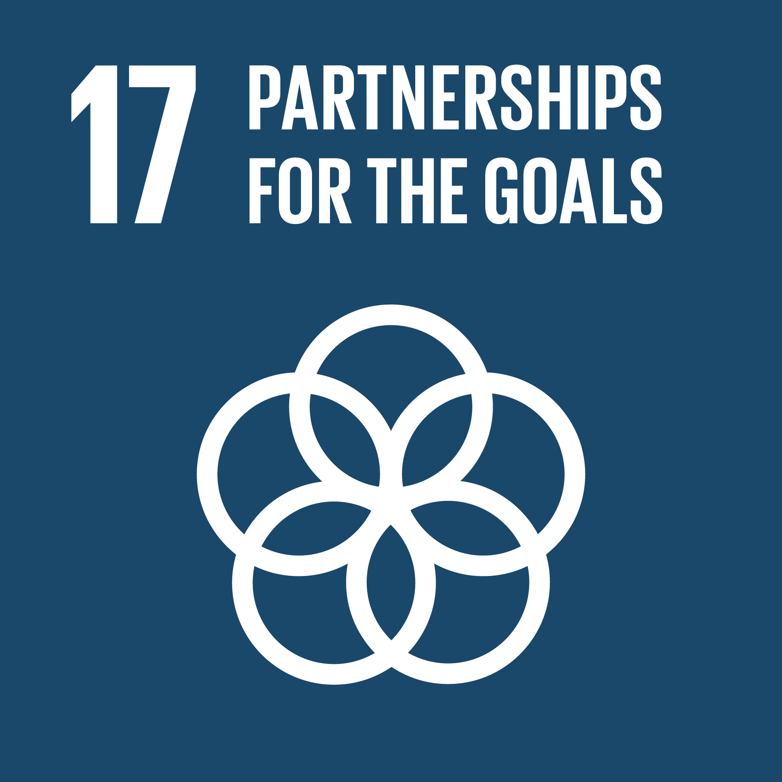

Complex goals depend on coordinated systems.
Capacity Starts With Resources
Cooperation Enables Scale
Sustainable development depends on predictable financing.
Domestic revenue, international assistance, and private investment shape what countries can plan and sustain. Debt stability matters as much as funding volume.
Short-term inflows cannot replace long-term capacity.
Progress accelerates when systems are connected across borders.
This includes:
Knowledge and data sharing
Access to science, technology, and innovation
Coordinated support across institutions and regions
When cooperation is fragmented, effort is duplicated. When it is aligned, capacity builds faster.
Technology transfer, joint research, and shared standards allow solutions to scale.
Rules Make Participation Possible
Clear rules allow countries to participate reliably in global systems.
Transparent and predictable trade frameworks
Reduced barriers for least developed countries
Fair access to international markets
What enables shared progress?
All about cooperation, collaboration and partnerships
Hisham Badr - The importance of global partnerships

Slide 32
How IITH is contributing to Sustainability?
IIT Hyderabad is at the forefront of sustainability, addressing climate change through innovative research, practical actions, and capacity building. With a vision to create an eco-friendly campus, IITH integrates cutting-edge technology with impactful initiatives to reduce its environmental footprint and inspire global climate action.
Recognized for its efforts, IITH received the Haritha Haram Award in 2022, for its commitment to green practices. Strengthening its focus on sustainability, IITH partnered with Greenko to establish the School for Sustainable Science and Technology, advancing research in renewable energy, waste management, and environmental resilience.
On campus, sustainability is embedded in daily operations. The 4.5 MW solar power plant, radiant cooling system, and zero waste policy demonstrate IITH’s dedication to eco-friendly infrastructure. Initiatives like biodigesters, composting, and wastewater recycling ensure efficient resource management.
Students play a vital role in sustainability, participating in clean-up drives, plantation activities, and cycling promotion programs. These efforts cultivate a culture of environmental responsibility. With its innovative practices and active student involvement, IIT Hyderabad is paving the way for a greener future, inspiring sustainable living across the globe

Slide 33
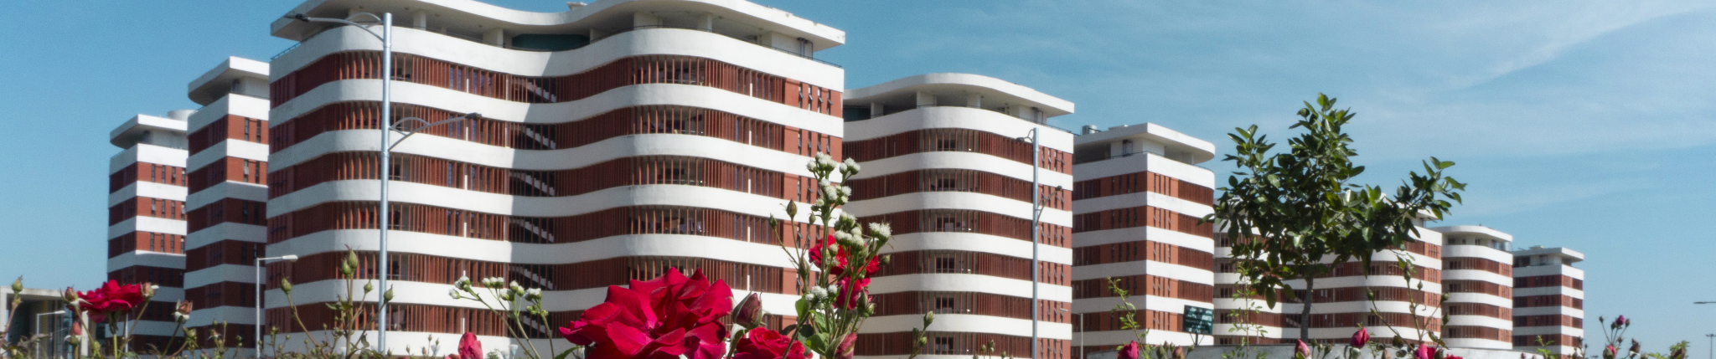
Ecological Stewardship
IIT Hyderabad has emerged as an oasis of biodiversity within a rapidly transforming landscape. The campus undertakes monthly plantation drives, strengthening native ecological processes. Last year, IIT Hyderabad also hosted a large-scale monsoon plantation drive, resulting in the planting of over 2,000 trees across carefully designed patches. These patches are envisioned as future ecosystems for birds, butterflies, and insects, and include diverse plantation spaces such as fruit gardens, focused biodiversity zones, and walking trails with tree species selected based on canopy structure.
The campus actively contributes to bird conservation initiatives and has documented over 60 bird species, recently published in a dedicated book on the birds of IIT Hyderabad. One of the most recent and unique efforts is the creation of a butterfly garden, designed as a mini island habitat to support butterfly populations on campus. Together, these initiatives demonstrate IIT Hyderabad’s commitment to integrating biodiversity conservation into large-scale campus development, reinforcing sustainability through ecological stewardship.

Slide 34
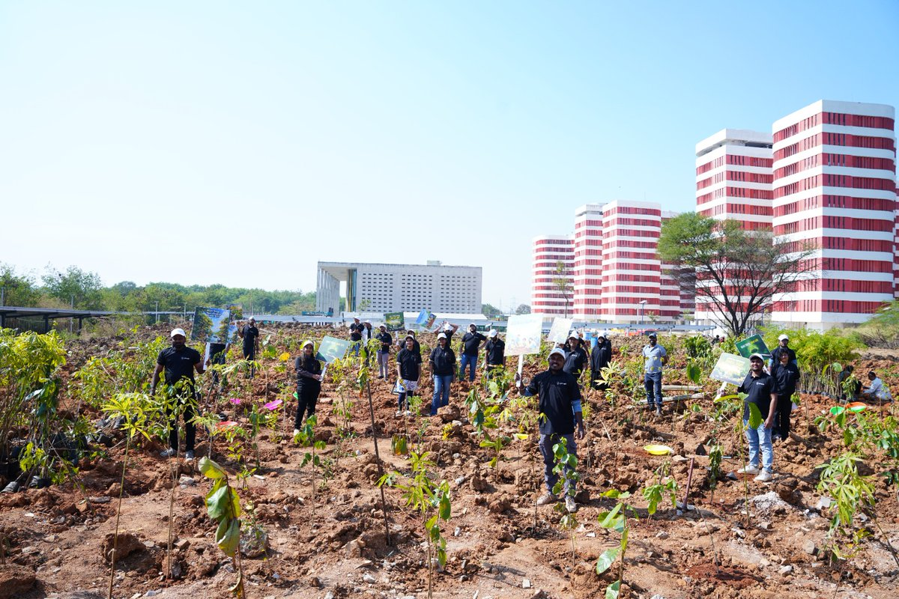
Miyawaki Forest @ IITH
3,000 saplings were planted by Green Office, IIT Hyderabad, using the Miyawaki plantation technique to strengthen the green cover and biodiversity at IIT Hyderabad
The Miyawaki method supports the rapid growth of dense, native forests, creating self-sustaining green lung spaces with long-term ecological benefits.
This plantation drive was carried out with CSR support from Genpact and implemented by united way hyd , with the active participation of 50 Genpact volunteers, IITH students and faculties.
Miyawaki forest plantation drive by Green Office, IIT Hyderabad

Slide 35
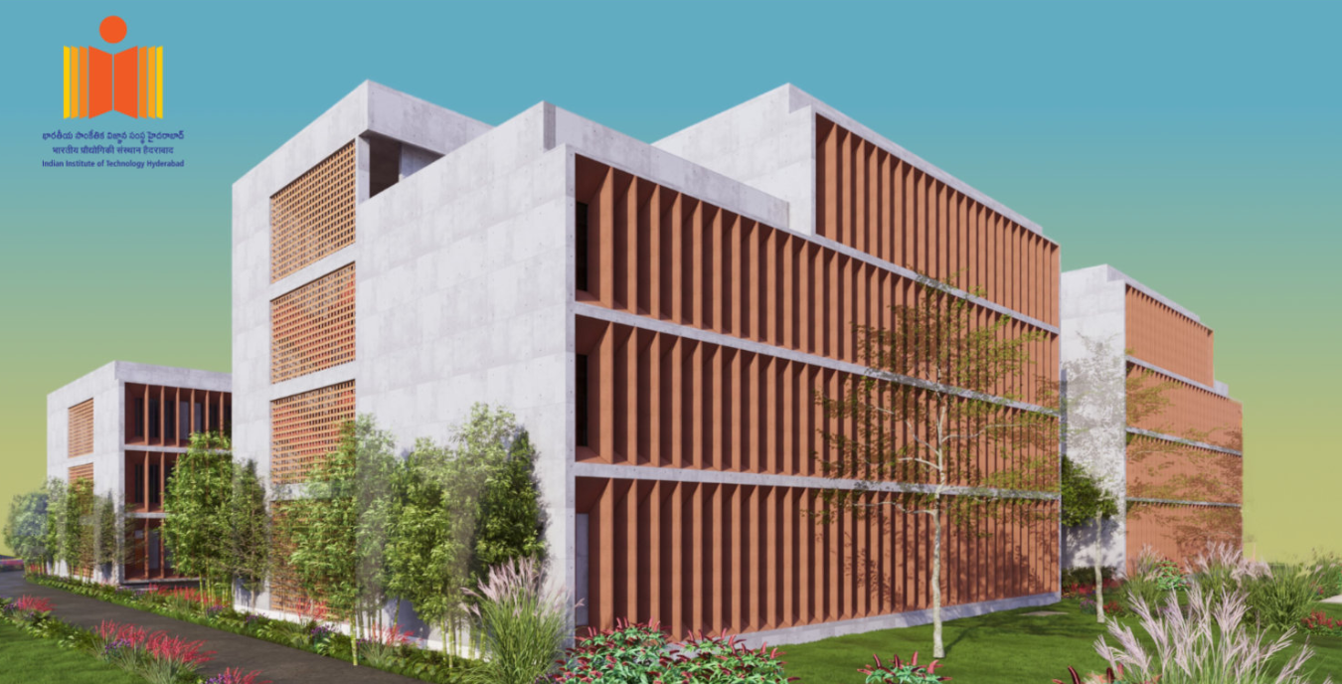
Greenko School of Sustainability @ IITH
Greenko Group and IIT Hyderabad are collaborating to establish the Greenko School of Sustainability at the Indian Institute of Technology Hyderabad.
The School of Sustainability is designed to shape a world that harmonizes with nature and empowers future generations toward a more sustainable tomorrow. The objectives of the school are to conduct research and development, education programs.
The Greenko School of Sustainability will be structured as a cross-disciplinary center that manages seamless participation and knowledge flow from all existing departments and centers of IIT Hyderabad.
Link to Greenko School of Sustainability: https://gss.iith.ac.in

Slide 36
Department of Climate Change @ IITH
Greenko Group and IIT Hyderabad are collaborating to establish the Greenko School of Sustainability at the Indian Institute of Technology Hyderabad.
The School of Sustainability is designed to shape a world that harmonizes with nature and empowers future generations toward a more sustainable tomorrow. The objectives of the school are to conduct research and development, education programs.
The Greenko School of Sustainability will be structured as a cross-disciplinary center that manages seamless participation and knowledge flow from all existing departments and centers of IIT Hyderabad.
Link to Greenko School of Sustainability: https://gss.iith.ac.in

Slide 37
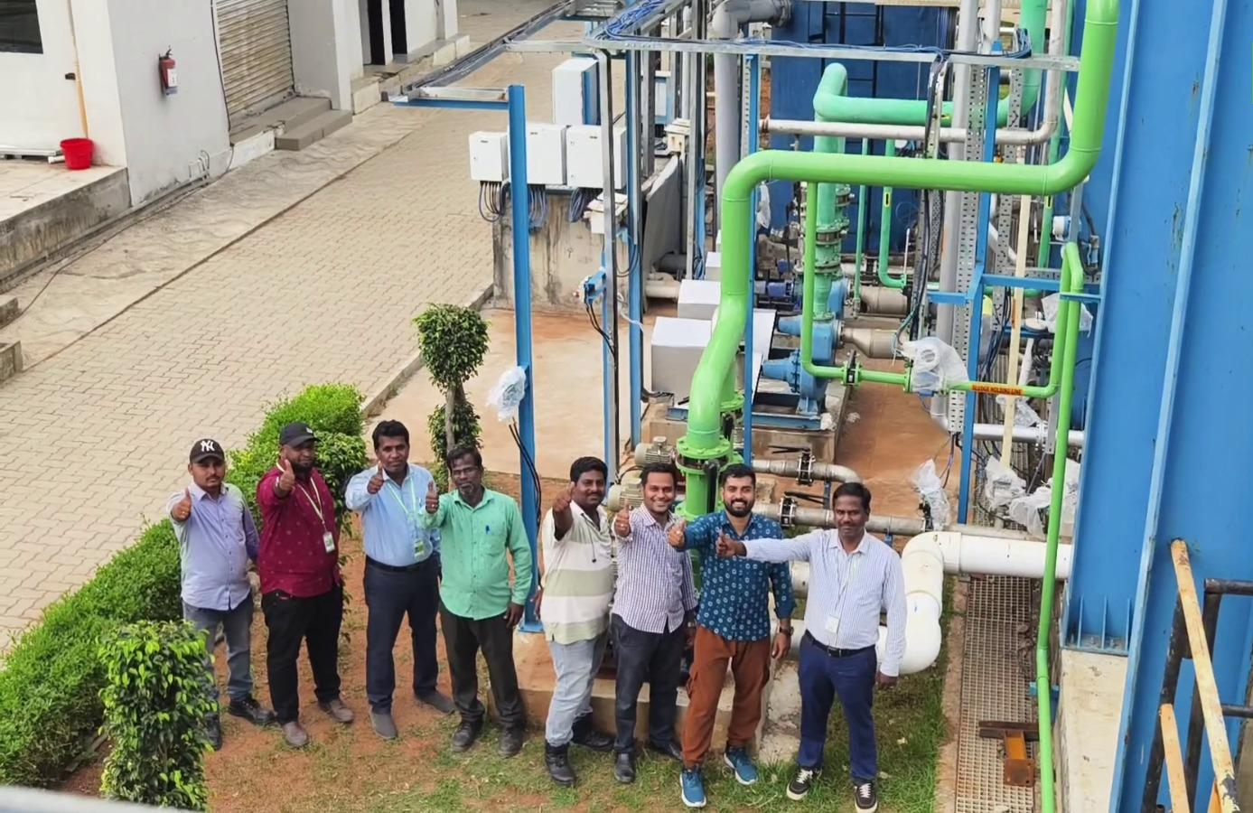
Waste Management @ IITH
IIT Hyderabad has set up a comprehensive waste management system. The campus already has a functional sewage treatment plant based on Membrane Bioreactor Technology. We have set up a comprehensive solid waste management system.
The solid waste generated on the campus is broadly separated into dry and wet categories. Wet waste (food waste, vegetable peelings, etc. which are readily biodegradable) generated in hostel mess, is shredded, and fed into a biogas digester.
The generated biogas is used in the students’ dining facility. This reduces the consumption of fossil fuels. The wet waste from the residential areas is sent to the vermicompost facility at the RRP. The compost is used for gardening purposes.
IIT Hyderabad (IITH) operates a sustainable campus with a 650 KLD (Kilolitres per Day) capacity Sewage Treatment Plant (STP) using advanced Membrane Bioreactor (MBR) technology. This eco-friendly facility treats campus wastewater for reuse in cooling towers and flushing, while wet waste is processed into biogas for dining facilities.

Slide 38
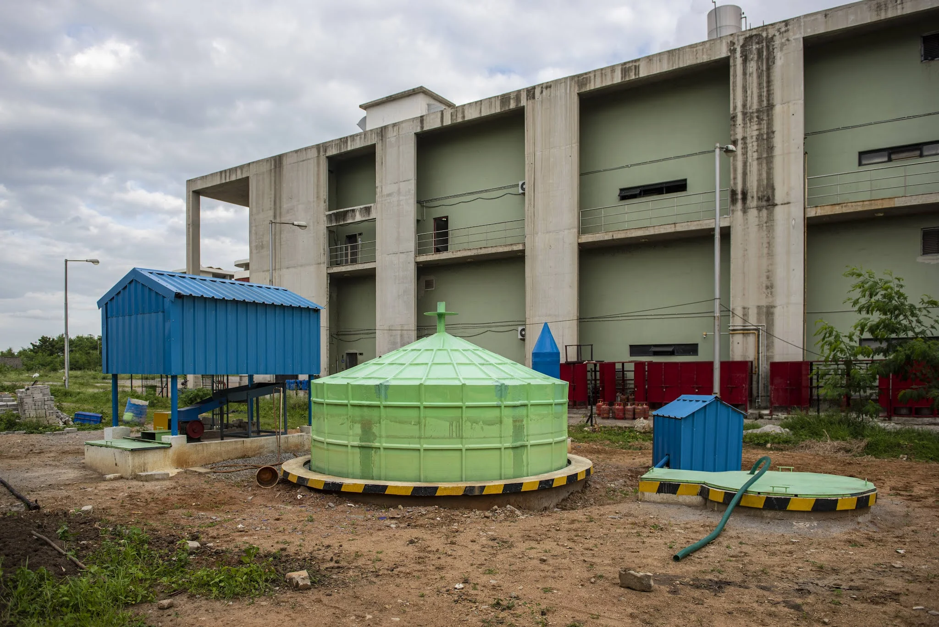
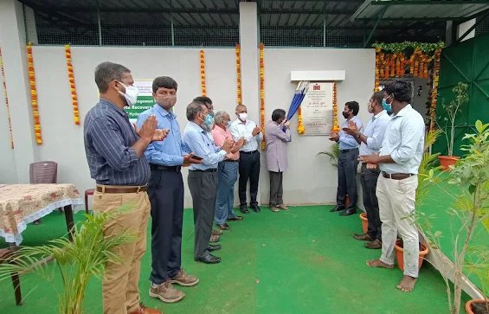
Waste Management @ IITH
Our campus has a door-to-door waste collection mechanism with a clear segregation at the residences into wet and dry waste. The waste is brought to the Resource Recovery Park (RRP) using a battery-operated collection vehicle.
At RRP, the dry fraction is further segregated into individual components, while the wet waste is sent to the compost facility. The dry waste is segregated at the RRP facility into individual components. The compacted waste is temporarily stored in RRP and disposed of by external agencies.
Bio-Digester at IITH
Inauguration event of RRP
More on IITH’s efforts in waste management can be seen here: https://pr.iith.ac.in/pressrelease/CWM.pdf

Slide 39
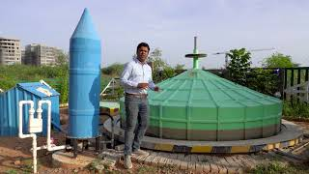

Slide 40
Power Management @ IITH
IIT Hyderabad follows an integrated approach to power management by combining solar energy generation with energy efficiency measures across the campus. Solar installations contribute an increasing share of the institute’s electricity demand, while energy-efficient appliances and optimized building systems help reduce overall consumption.
These initiatives are supported by continuous upgrades to campus infrastructure, enabling more efficient energy utilization and minimizing losses. Advanced cooling strategies, efficient lighting, and system-level optimizations further enhance overall performance and reduce peak demand.
In addition, the institute is expanding its renewable capacity and improving energy management practices to align energy generation with evolving consumption patterns. Collectively, these efforts aim to reduce dependence on conventional energy sources, lower carbon emissions, and strengthen the institute’s pathway towards achieving its Net-Zero Carbon goals by 2040.

Slide 41
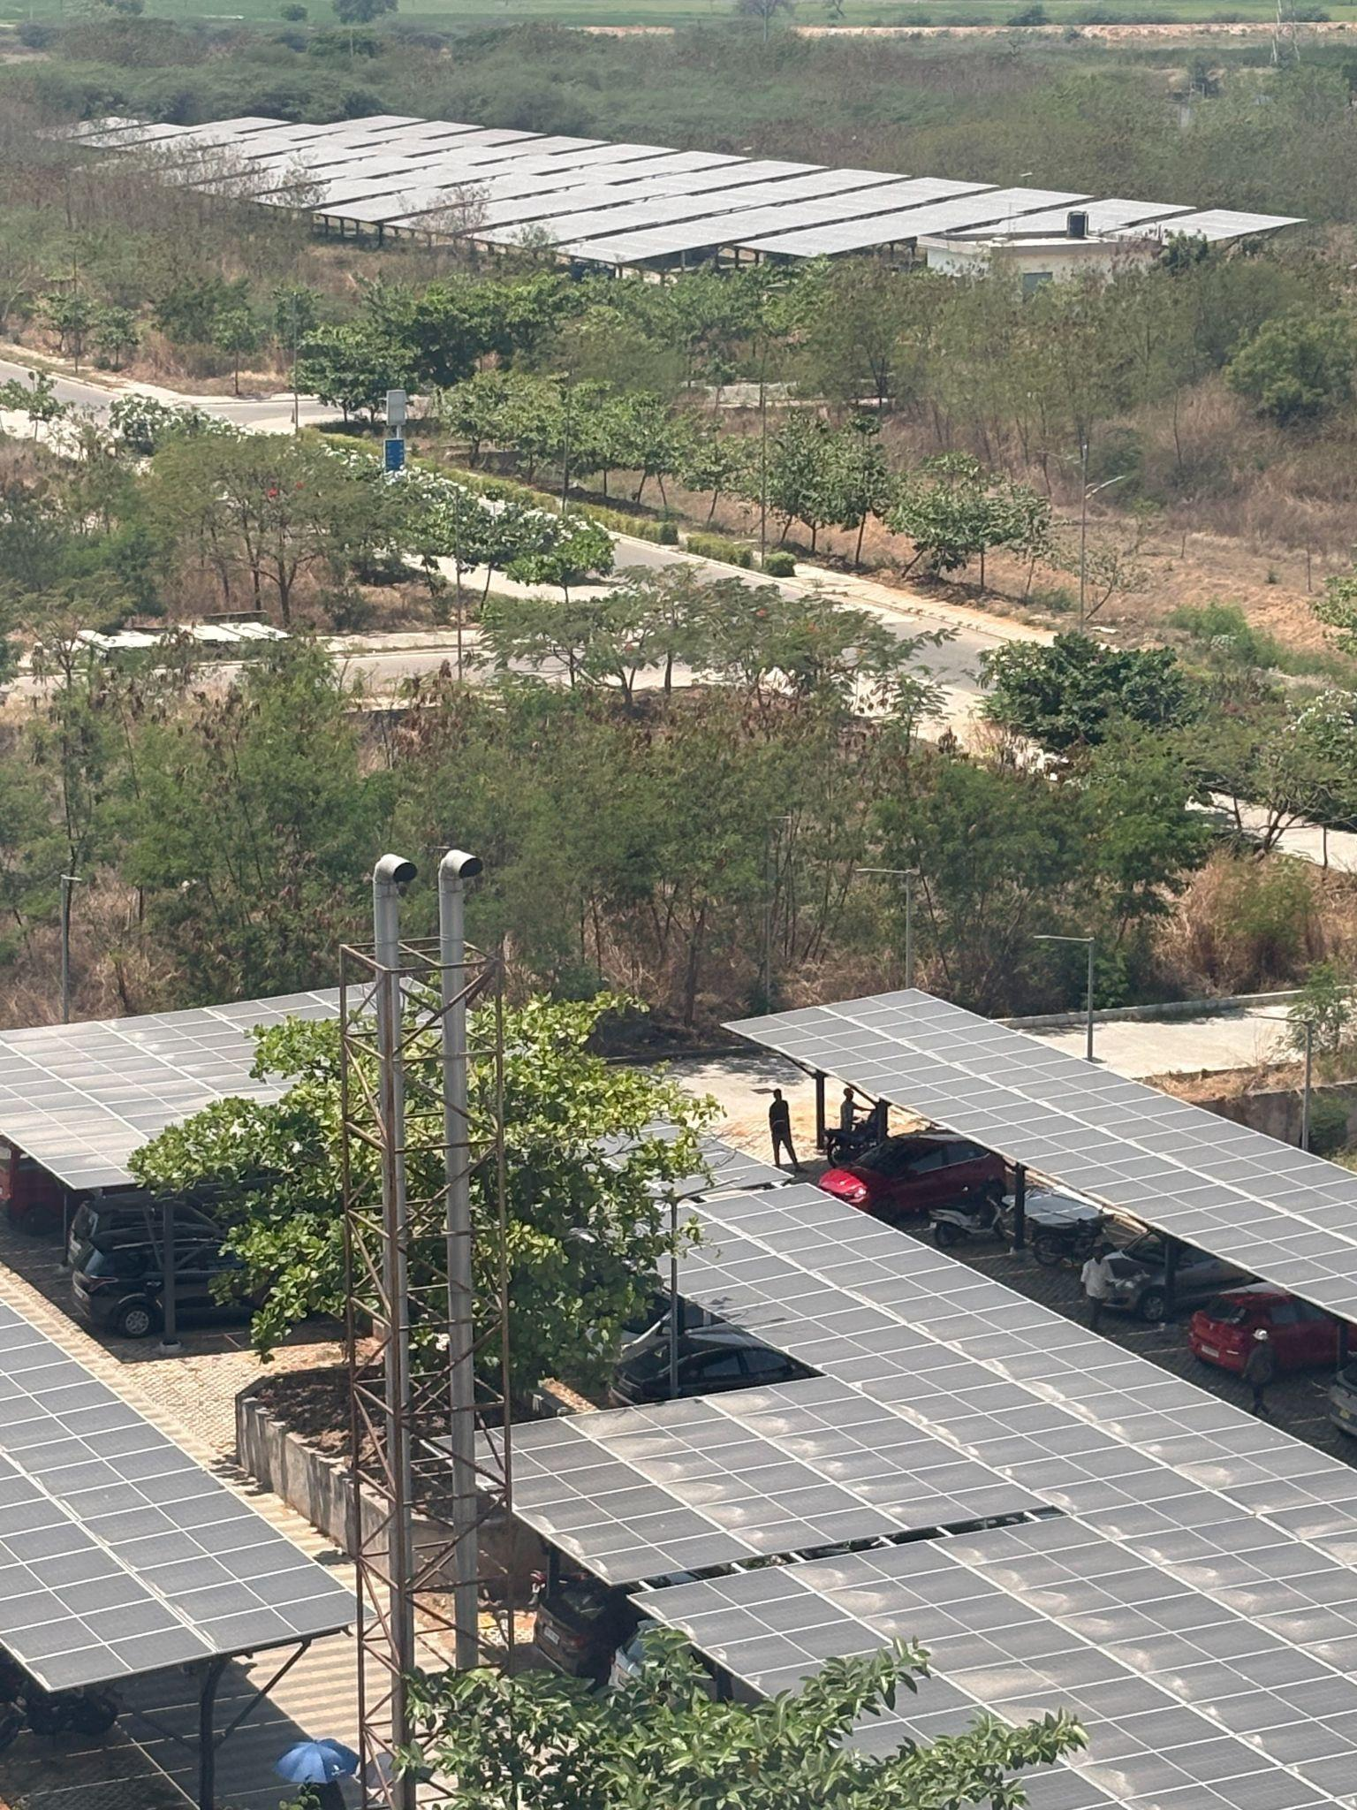
Power Management @ IITH: Solar Power
IIT Hyderabad integrates solar energy through extensive rooftop and infrastructure-mounted panels, providing a clean and reliable source of power for lighting and hot water systems.
The campus currently operates close to 4.5 MW of solar power, enabling a significant share of its electricity demand to be met through renewable sources, thereby reducing dependence on conventional energy and lowering its carbon footprint.
[Figure: Right]: Solar panels covering parking areas in IITH. A total installed capacity of 4.5 MW is currently in use.

Slide 42
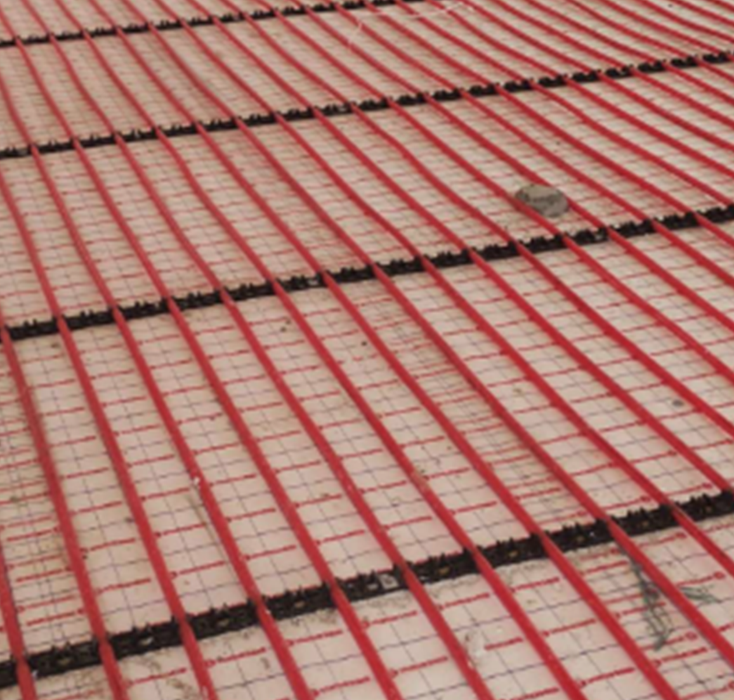
Power Management @ IITH - Radiant-Cooling
The campus employs radiant cooling systems in hostel buildings, where chilled water is circulated through pipes embedded in ceilings to absorb heat directly from indoor spaces. This method provides thermal comfort while consuming significantly less energy than conventional air-conditioning.
Designed with integrated cooling infrastructure and passive features such as optimized windows to reduce heat gain, the system minimizes electricity use. As a key innovation in campus design, radiant cooling supports the institute’s Net-Zero goals while demonstrating an efficient and scalable approach to sustainable climate control.
Radiant cooling technology being used at IITH hostels

Slide 43
Power Management @ IITH - Better Appliances
The campus is transitioning to energy-efficient appliances and systems across academic and residential buildings to reduce overall electricity consumption. This includes the installation of high-efficiency BLDC ceiling fans, automated LED lighting systems, and other low-energy devices designed to minimize power usage without compromising performance.
These measures reduce overall energy demand and complement renewable energy initiatives on campus. Together, they contribute to lowering operational emissions and support the institute’s broader sustainability and Net-Zero goals.

Slide 44
Policies to ensure sustainability @ IITH
Policies | Link
Policy to become a Net Zero Campus by 2040 | Link
Policy to integrate sustainability principles to procurement process of IITH | Link
Anti-Bribery and Anti-Corruption Policy | Link
Equality, Diversity, and Inclusion Policy | Link

Slide 45
How can you be more sustainable?

Slide 46
How to Ask the Right Questions for Sustainable Decision Making?
Environmental Impact
Ask:
Does this action reduce resource consumption (energy, water, materials)?
What emissions, waste, or pollution does it generate—can these be minimized?
Does it protect or harm ecosystems and biodiversity?
Can renewable, recyclable, or low-impact alternatives be used?
Goal: Minimize environmental harm and promote regeneration.
Long-Term Thinking
Ask:
What are the long-term consequences of this decision (5–20 years)?
Will future generations benefit or bear hidden costs?
Is this solution durable, adaptable, and resilient?
Goal: Avoid short-term gains that create long-term risks.
Social Responsibility
Ask:
Who benefits and who might be negatively affected?
Does this decision promote equity, safety, and well-being?
Are vulnerable communities or stakeholders considered?
Goal: Ensure fairness, inclusion, and human well-being.

Slide 47
How to Ask the Right Questions for Sustainable Decision Making?
Economic and System Efficiency
Ask:
Is this economically viable without externalizing environmental or social costs?
Does it improve efficiency and reduce waste over time?
Does it encourage responsible consumption and production?
Goal: Support sustainable economic value, not extractive growth.
Ethical and Professional Integrity
Ask:
Would this decision align with professional ethics and public trust?
Would I be comfortable defending this choice transparently?
Does it align with sustainability standards, regulations, or best practices?
Goal: Act responsibly beyond minimum compliance.
Alternatives and Innovation
Ask:
Is there a more sustainable way to achieve the same objective?
Can design, technology, or policy choices improve the outcome?
Have interdisciplinary perspectives been considered?
Goal: Encourage innovation rather than default solutions.
One-Line Sustainability Test
“Does this decision improve outcomes for people, the planet, and the future—without shifting harm elsewhere?”
If the answer is unclear, the decision needs re-evaluation.

Slide 48
Sustainability Committee Thanks Mr. Nitish Kashyap, Mr. Ashik Lal Krishna, and Mr. Yashwanth M. for their contributions to this PPT.
We also thank various offices of IITH that has constantly contributed to improving and fostering sustainable practices in the pursuit of growth of IITH.
We thank the students, employees, and other residents of this campus for their care and concern regarding the sustainability of IITH and our world. We recoganize that there is still a lot to learn and hope all of us will continue to work towards being better stewards of a sustainable world.

